Slide 1
Community for Emerging and Zoonotic Diseases Q4 Signals of Interest for CSHIN
20 February 2025
www.cezd.ca

Slide 2
African Swine Fever Trends
Surge in cases in farmed pigs that occurred in third quarter of 2023 did not occur in 2024
Still a large number of outbreaks ongoing
African swine fever - WOAH - World Organization for Animal Health
Notes:
The Q3 surge of ASF in domestic swine that we saw last year has not occurred this year.

Slide 3
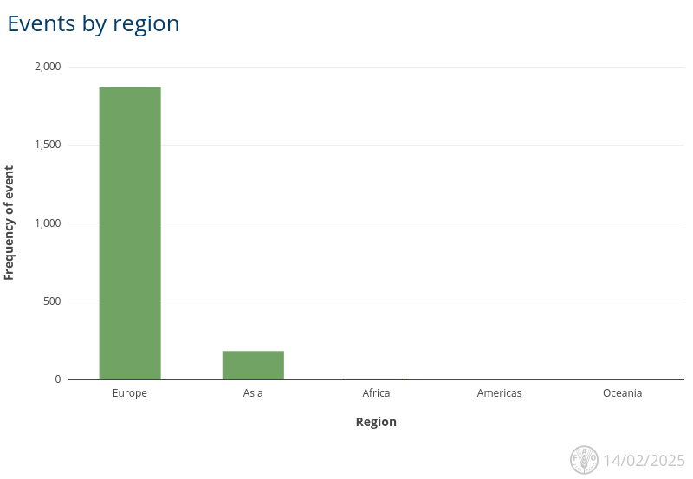
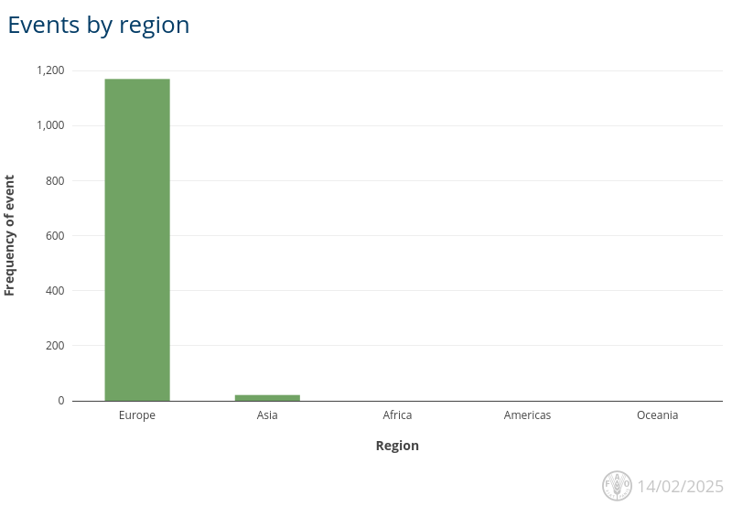
Q4/Q1 ASF Outbreaks by Region
Cases in Europe are reliable numbers
Cases from Asia are significant underestimates as China not included in data from Empressi
Q4
Europe (1,868)
Asia (181)
Africa (5)
Q1 to date
Europe (1,169)
Asia (21)
https://empres-i.apps.fao.org/general
Notes:
We have confidence there are a high number of cases continuing in Europe, but China and India are not reporting cases routinely to WOAH, yet we see evidence of ASF cases in media reports and scientific findings from those countries. India has ASF included in its 6 monthly reports but hasn’t uploaded anything since 2nd trimester of 2023. China does not include cases in its 6 monthly reports, and it indicates its last detections were in 2021.

Slide 4
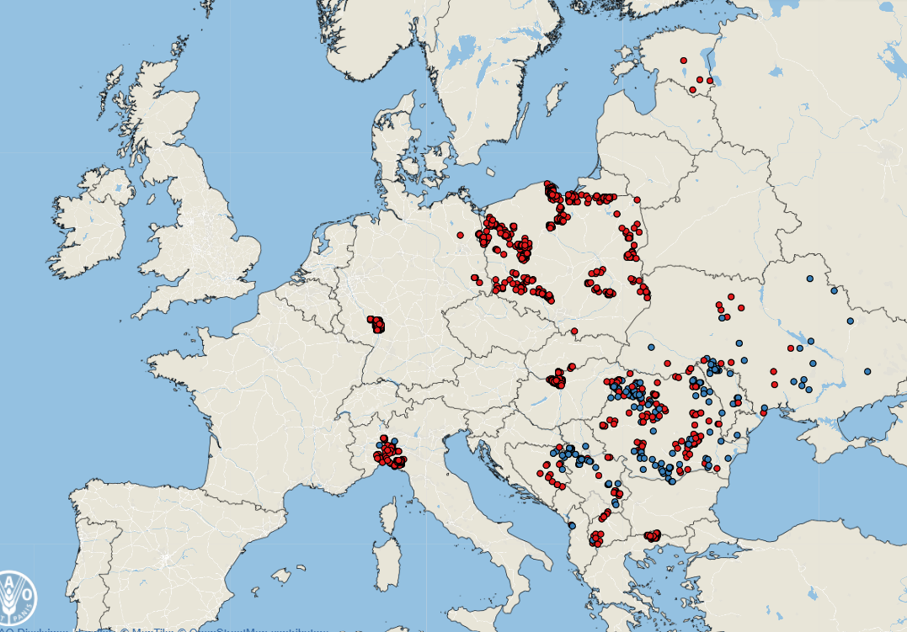
Notable ASF Cases - Europe
No great changes in distribution from last report
1868 cases in Europe in Q4
1171 cases so far in Q1
New country in Q4 – Albania
November – Wild Boar
December – Domestic Swine
Wild Boar
Domestic Swine
Q4
https://empres-i.apps.fao.org/general

Slide 5
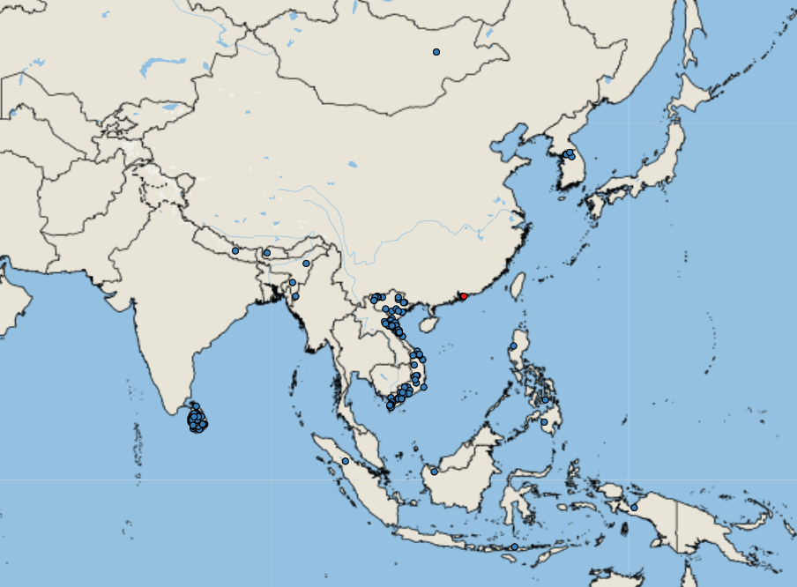
Notable ASF Cases - Asia
No great changes from Q3 in WOAH reported events
181 Events Q4
34 so far in Q1
Expect this is greatly under reported
Cases from India and China not reported
Q4
Empres-Plus

Slide 6
FAO ASF situation in Asia & Pacific update
Few cases from Philippines reported but many more on their own website

Slide 7
FMD Hazard Trend
COVID
Indonesia
SAT-2
Middle East
Germany
Notes:
This is our FMD hazard trend, which shows the spike when FMD was reported in Germany, previous events are visible on the trendline and we really had returned to baseline FMD cases when this one occurred.

Slide 8
Reported FMD Cases
Cases in Q4 – 22 events
17 Asia
12 Indonesia (O)
3 West Bank (O)
2 China (O)
5 Africa
South Africa (3 SAT-2, 1 SAT-1)
Algeria (O)
So far in Q1 - 8 events
1 Europe
Germany (0)
2 Asia
2 Israel (O and ?)
3 Africa
4 Libya (O)
1 Algeria (O)
Q4
Empres-Plus

Slide 9
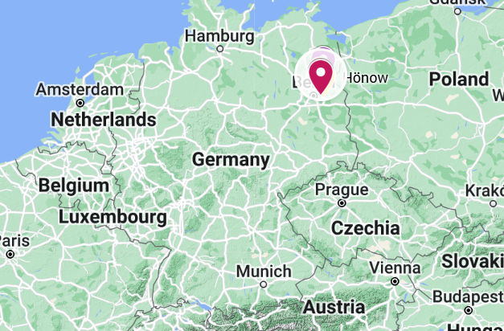
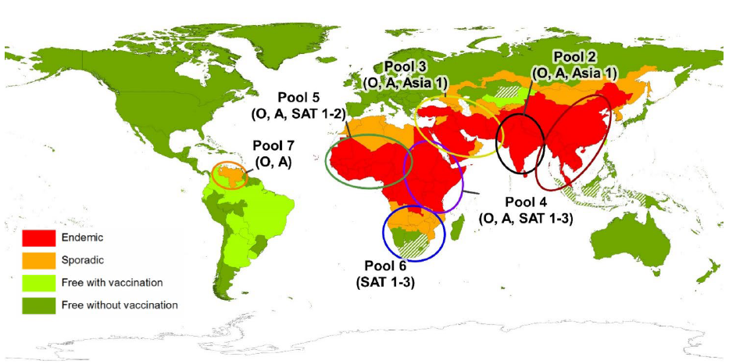
Foot and Mouth Disease in Germany
Germany has reported a case of FMD in water buffalo in Brandenburg (Jan 10)
First occurrence since 1988
Three buffalo have died, and the rest of the herd (11) have been culled
Identified as serotype O – closest to an isolate from Türkiye Dec 2024
Vaccines available in German FMD antigen bank
Vaccine will be made, uncertain if used
Source of infection is still unknown
Backyard farm “organic”, feed hay from own fields
No trade within epidemiologically significant period
Foot-and-mouth disease - European Commission
Global Distribution of FMD – Merck Veterinary Manual
Notes:
Germany reported an outbreak of FMD in water buffalo in Honow, outskirts of Berlin, on Friday (Jan 10th).
This is the first report of FMD in the country since 1988 (which occurred in lower saxony). And the last outbreak in Europe was reported in Bulgaria in 2011. FMD remains endemic in Turkey, the Middle East, Africa, parts of Asia and South America.
In this event - three water buffalo in Honow have died and the entire herd (remaining 11 buffalo) were culled as a precautionary measure. You can see on the map on the top right where this is in Germany.
The serotype has been identified as O – which is closely related FMD viruses are found in the Middle East and Asia, - You can see from the bottom right image the different pools for FMD worldwide and serotype O is present in all of them except for pool 6 which is in southern Africa. But the closest in proximity to Europe would be those circulating in the middle east (pool 3)
The sequence is closest to strains from Turkiye in December 2024 https://food.ec.europa.eu/animals/animal-diseases/diseases-and-control-measures/foot-and-mouth-disease_en but has also been found in India, Nepal and Iran
The exact origin and route of entry is still unknown, and it is interesting that it was detected in water buffalo and its listed as a backyard farm
But it also shows that the risk of introduction of this virus into a susceptible population can happen anytime.

Slide 10
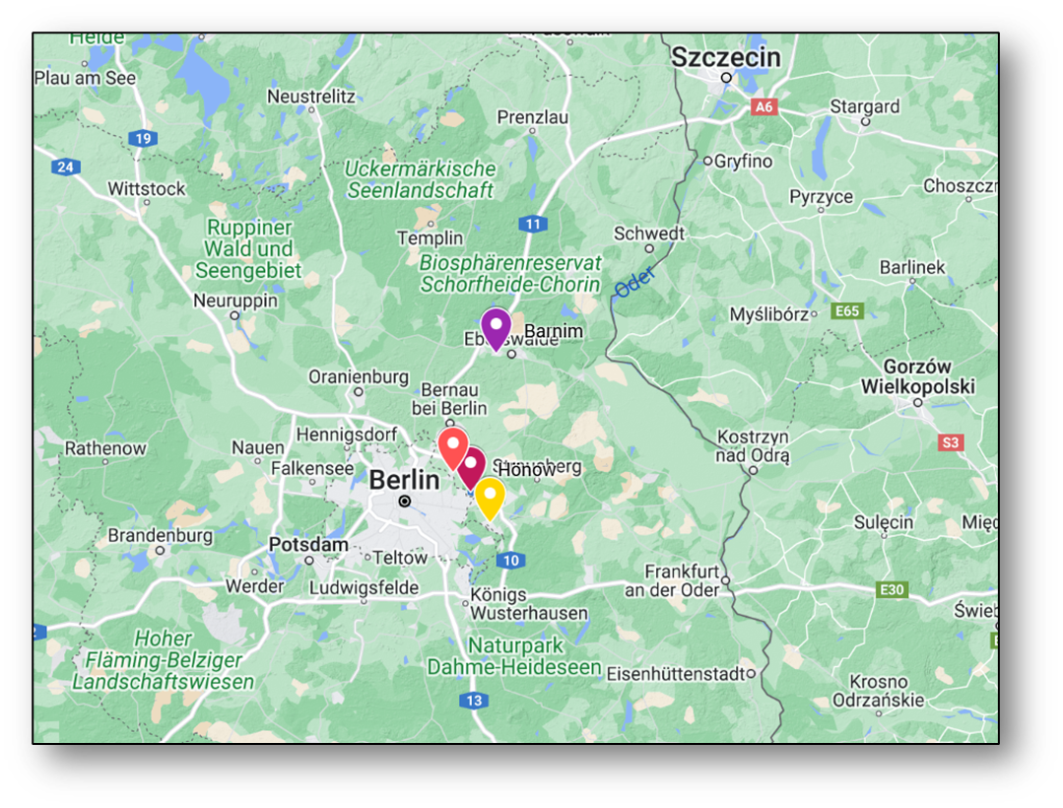
Response to date
Immediate transportation ban (5 days)
All susceptible livestock within a 1km radius culled
~200 pigs in Ahrensfelde culled, all tested negative
3km protection zone
10km surveillance zone
Sampling of all establishments within the 10 km Zone complete, all results negative to date
All clinically normal
DEFRA FMD Outbreak Assessment
Notes:
Immediate transportation ban (5 days) in Brandenburg
- all susceptible livestock within a 1km radius would be culled as a precaution and this includes a pigs farm with ~ 200 pigs in Ahrensfelde, near where the outbreak was detected.
- Additionally, 55 sheep and goats and 3 cattle from a farm in OderSpree are to be slaughtered on 13 January as the farm had obtained hay from the farm in Hönow where the outbreak occurred but none of the animals have shown signs of infection. The sampling of all establishments within the 10km Restriction Zone (RZ) is ongoing, but so far results have been negative. There is also a hunting ban in place in the restriction zone and berlins two zoo’s have closed.
- Netherlands have implemented a national ban on the movement of veal calves (unless they are going to slaughter) and a ban on visitors to veal farms because there have been more than 3,600 calves transported from Brandenburg to the Netherlands since 1 December. These calves are located on more than 125 veal calf farms spread across the Netherlands.
Re-testing of samples which tested negative for bluetongue for FMD as bluetongue can be a differential diagnosis for FMD
Protection Zone: means a zone where specific biosecurity and sanitary measures are implemented to prevent the entry of a pathogenic agent into a free country or zone from a neighbouring country or zone of a different animal health status.

Slide 11
Response to date
55 sheep and goats and 3 cattle from a farm outside the 10 km radius slaughtered as they had purchased hay from the index site
all clinically normal and tested negative
Goats (Barnim) with clinical signs tested negative on PCR and serology
Foot and Mouth Disease | Friedrich-Loeffler-Institut
WAHIS
DEFRA FMD Outbreak Assessment
Notes:
55 sheep and goats and 3 cattle from a farm in OderSpree (Yellow marker) were slaughtered on 13 January as the farm had obtained hay from the farm in Hönow where the outbreak occurred but none of the animals have shown signs of infection and have since tested negative.
- Goats in Barnim (the purple marker on the map) had clinical signs but were PCR and antibody negative

Slide 12
Response to date
Hunting ban put in place in the 10 km zone
Berlins zoos closed
Tested susceptible species
Netherlands ban on veal calves from Brandenburg
>3,600 imported from Brandenburg since December 1) to ~120 farms – all tested
Netherlands retesting samples tested for bluetongue, to date all negative
Missing Link – source of infection
DEFRA FMD Outbreak Assessment – Risk to UK considered Medium
Notes:
There is also a hunting ban in place in the restriction zone and berlins two zoo’s have closed.
- Netherlands have implemented a national ban on the movement of veal calves (unless they are going to slaughter) and a ban on visitors to veal farms because there have been more than 3,600 calves transported from Brandenburg to the Netherlands since 1 December. These calves are located on more than 125 veal calf farms spread across the Netherlands.
Re-testing of samples which tested negative for bluetongue for FMD as bluetongue can be a differential diagnosis for FMD

Slide 13
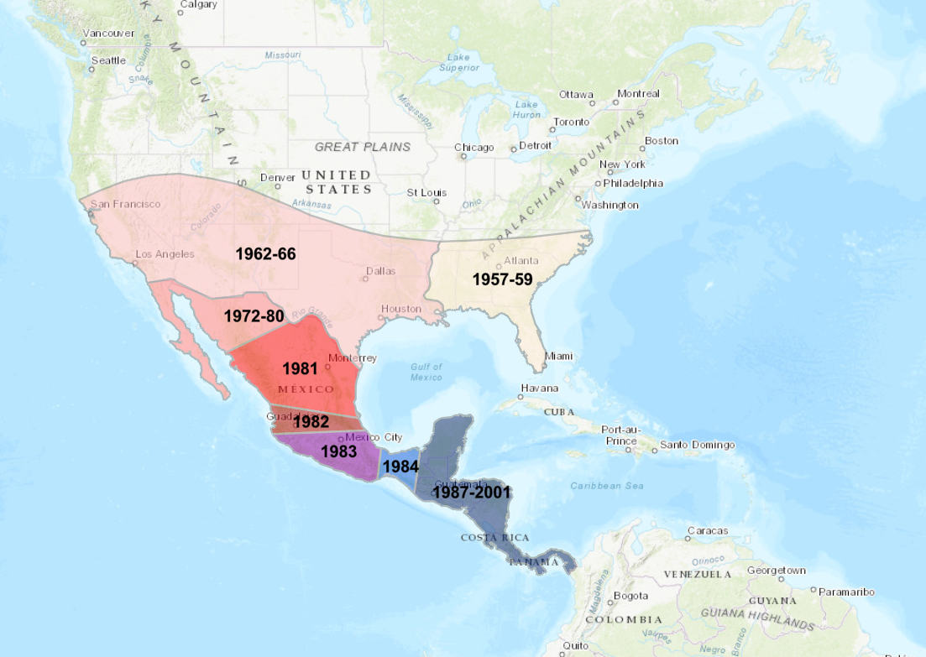
New World Screwworm in North and Central America
Parasitic fly larva - Cochliomyia hominivorax causing wound myiasis
Endemic in South America
Had been eradicated from the United States and Central America between 1957 – 2001 using sterile male flies
Re-emergence in Florida Keys in 2016 but that has been controlled
Normally, Panama is the control point with millions of sterile flies released to control northward movement
New World Screwworm (usda.gov)
https://www.iaea.org/services/technical-cooperation-programme/new-world-screwworm

Slide 14
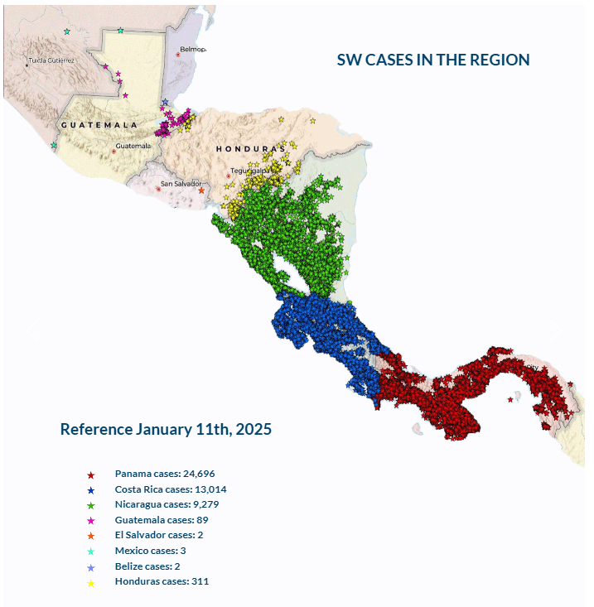
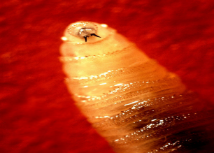
New World Screwworm in Central & North America
Re-emergence with steady northward movement since summer 2023
Cases as of January 11, 2024, according to COPEG:
Panama – 24,696
Costa Rica – 13,014
Nicaragua – 9,279
Honduras – 311
Guatemala - 89
Mexico - 3
El Salvador - 2
Belize – 2
Human cases: Costa Rica, Panama, Nicaragua
Increase in may be due to more aggressive fly, increased rainfall, sterile fly program mismanagement, illegal cattle trafficking, rearing cattle in ‘barrier’ areas in Panama
Impacts on wildlife unclear, difficult to know extent of cases
k7576-1 : USDA ARS

Slide 15
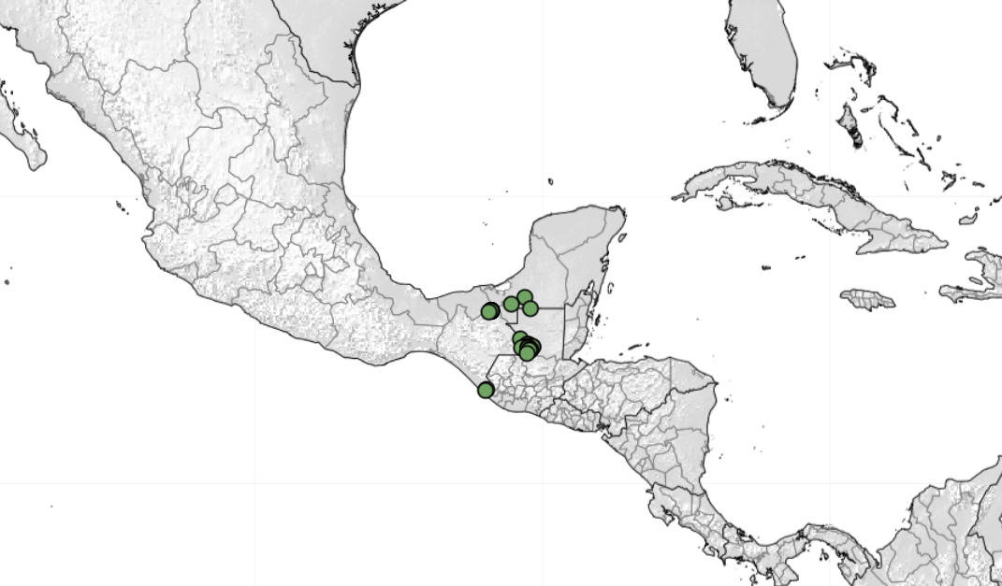
Mexico Notifies United States of New World Screwworm Detection | Animal and Plant Health Inspection Service
The NWS was found in a cow in the southern Mexico state of Chiapas,1/100 cows had an ear lesion at border inspection (Nov 2024)
Immediate trade restrictions issued by USDA
Trade in cattle stopped between Mexico and US (normally >1 million animals per year),
Cattle trade resumed in early February requiring treatment and pre-clearance inspection
42 cases to date 33 cattle, 8 horses, 1 swine
Enhanced Surveillance
Ongoing Sterile Fly Releases
15

Slide 16
New World Screwworm and Canada
Awareness at ports of entry for travel related cases in dogs and horses travelling to Central America and Mexico
Travel related human cases possible
Massive economic impacts in the US if it successfully migrates that far north
Regulated diseases - Terrestrial animals – Merlin
https://www.cfsph.iastate.edu/Factsheets/pdfs/screwworm_myiasis.pdf
Susceptible to freezing/near freezing
Need 25-30C and relative humidity of 30-70%
Improbable that the fly could establish in Canada
If arrived in summer may cause damage before being killed off in winter
Notes:
The eradication of NWS in the United States yielded annual economic benefits to producers estimated at $796 million¹ in 1996, with an estimated $2.8 billion¹ benefit to the wider economy.

Slide 17
Scientific Findings
SHIC Monitors Recombinant ASFV Genotype I/II Strain Emergence Globally – Swine Health Information Center
SHIC Lit Review Outlines Current Information and Knowledge Gaps for H5N1 Risk to Swine – Swine Health Information Center
Novel Porcine Getah Virus from Diarrheal Piglets in Jiangxi Province, China: Prevalence, Genome Sequence, and Pathogenicity
A case report of porcine circovirus 3 (PCV3) reproductive disease in Iberian semi-outdoor reared sows – PubMed
Revisiting the risk of introduction of Japanese encephalitis virus (JEV) into the United States – An updated semi-quantitative risk assessment – ScienceDirect
Experimental inoculation of pigs with monkeypox virus results in productive infection and transmission to sentinels - PubMed

