Slide 1
Community for Emerging and Zoonotic Diseases Identifying emerging risks through collective intelligence
CEZD – CAHSS Vector Network Update
24 March 2025
www.cezd.ca

Slide 2
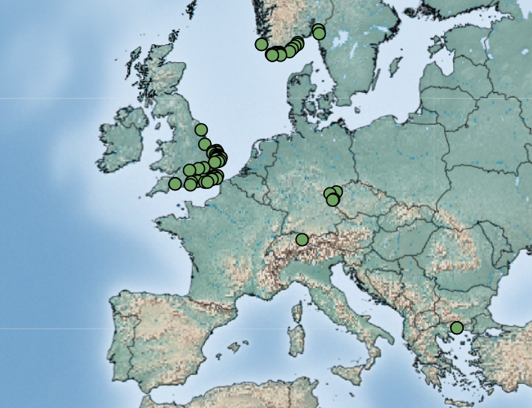
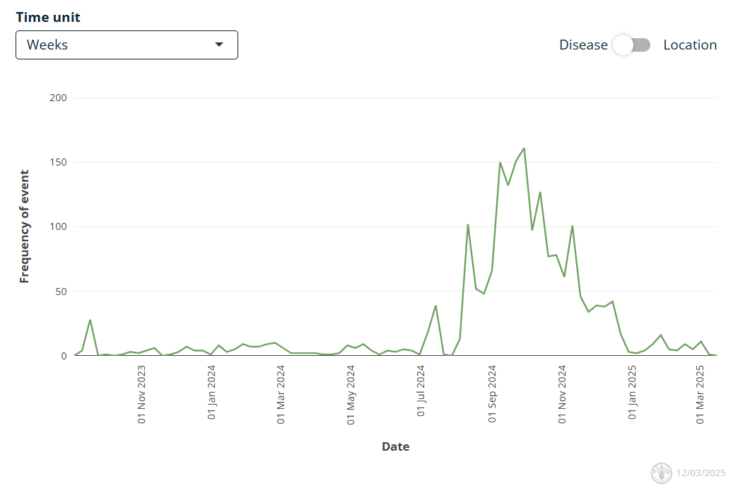
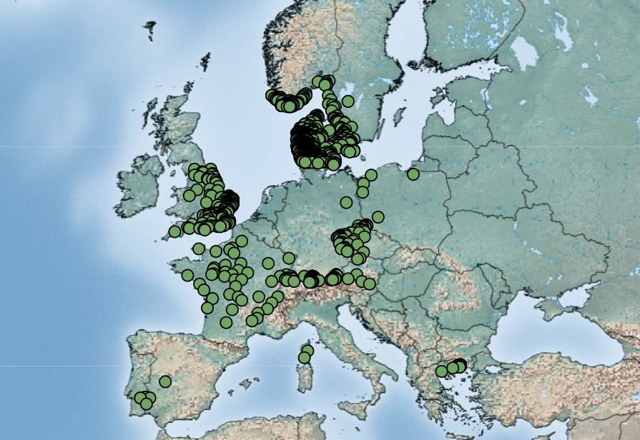
Bluetongue virus (BTV-3) in Europe
First reported Sept 5, 2023 in the Netherlands
Source of infection has never been identified
Continued reports of cases throughout the winter but significant decrease in cases now
BTV-3 Jan 1, 2025 – March 12, 2025
Empres-Plus
BTV-3 Sept 1, 2024 – March 12, 2025
Notes:
Norway continues to report cases of BTV-3, and has been reporting cases throughout the entire winter

Slide 3
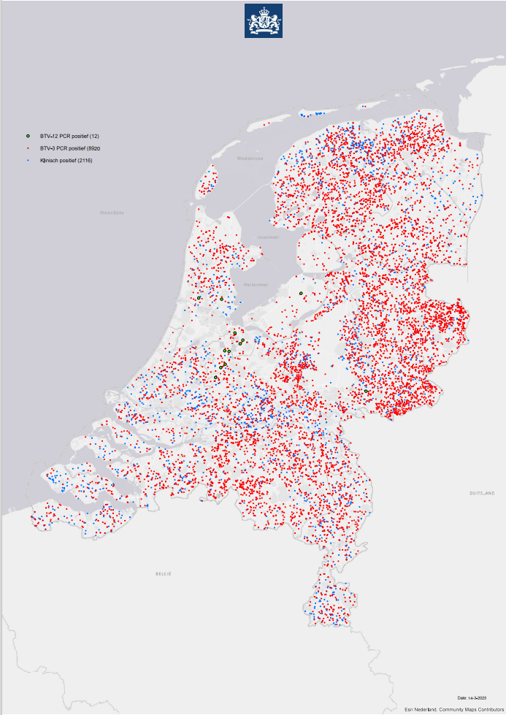
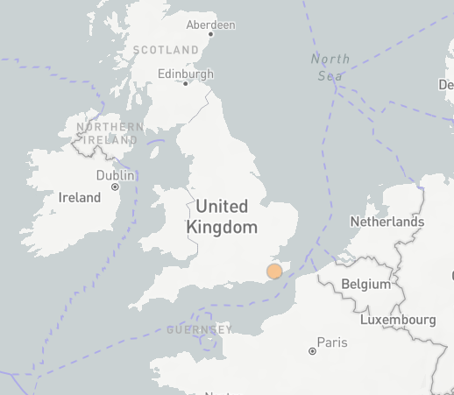
Bluetongue virus (BTV-12 & 4) in Europe
BTV-12
The Netherlands reported their first cases of BTV-12 on October 10, 2024, in a sheep on a farm in Kockengen and in a cow and her calf on a farm in Harmelen
Netherlands still only reporting 12 cases of BTV-12
England BTV-12 for the first time on February 2, 2025
Unclear how it was introduced, wind?
BTV-4
Slovenia reported a reoccurrence of BTV-4, previously reported in December 2016
Three cases were reported in cattle in the north of the country
Notes:
Bluetongue serotype 12 was also been detected in Europe for the first time in the fall of 2024, in the Netherlands last October and they have reported a total of 12 cases so far and England reported BTV 12 for the first time in February of this year on a farm with 15 cows, 1 positive for BTV 12 and three positive for BTV3
It is unknown how BTV-12 was introduced to the Netherlands, the serotype is common in other parts of the world, reported to WOAH by Israel (2010) and Australia (2015). However, it is commonly found in African countries, as is serotype 3.
The Netherlands is retrospectively examining their BTV-3 samples for evidence of BTV-12. Though it seems to be less virulent than BTV-3, the case in the UK had no clinical signs.
Unclear how these different serotypes keep being identified in the Netherlands [BTV-3 (2023), now BTV-12 (2024), and previously BTV-6 (in 2008)]. Is their diagnostics capacity better and its just going undetected in certain countries, or is it another transmission pathway directly into the Netherlands?
BTV-4 has recurred in the Slovenia after being absent for 9 years.

Slide 4
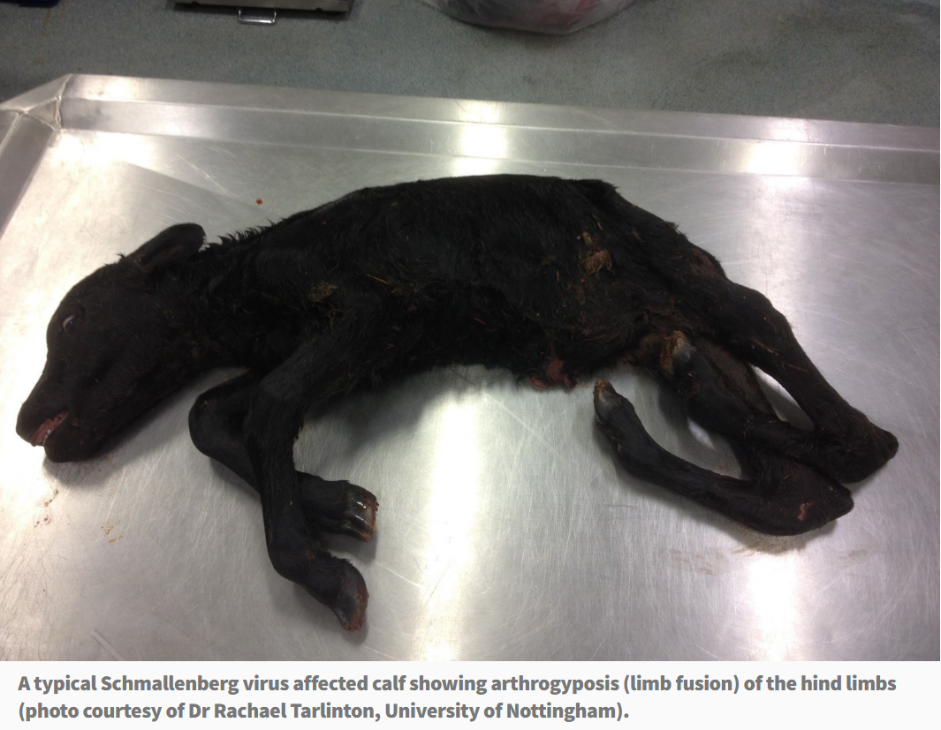
Schmallenberg virus in United Kingdom
Farmers fear being 'wiped out' if any more diseases strike (Scotland)
Ireland and Scotland reporting cases of SBV
Not notifiable, many cases going unreported across Europe
Spread by culicoides, may be experiencing increase in reports as with BTV
AHS - Current News (agriculture.gov.ie)
Notes:
Schmallenberg virus can affect cattle, sheep, and goats. Is transmitted by biting midges, and can cause fever, reduced milk yield, and in pregnant animals, abortions or birth defects
It was first detected in Germany in 2011 and then spread across Europe..

Slide 5
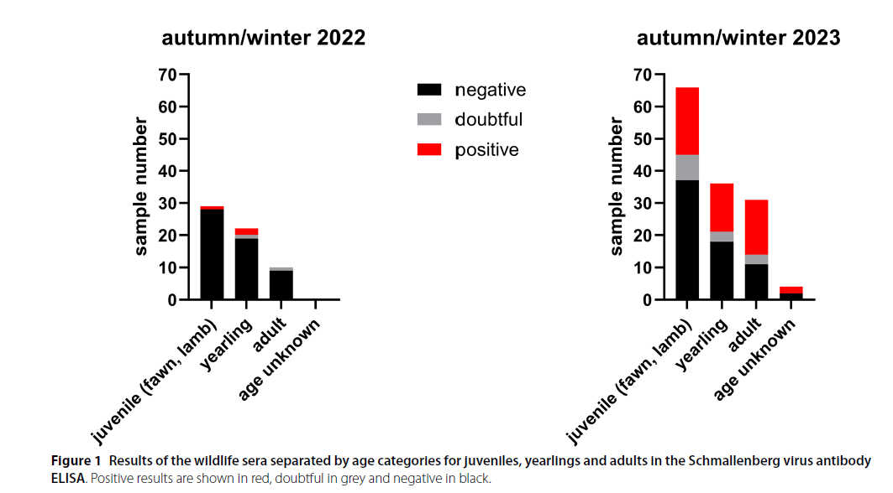
Extensive Schmallenberg Virus circulation in Germany, 2023
Sero-surveillance of wild ruminants for BTV and SBV
All animals seronegative for BTV
In 2022, seroprevalence in tested animals was 4.92% (n=61)
Red Deer and Roe Deer
In 2023, 40.15% of the animals tested positive (n=137)
Red Deer, Roe Deer, Mouflon and unknown species
Notes:
Schmallenberg virus can affect cattle, sheep, and goats. Is transmitted by biting midges, and can cause fever, reduced milk yield, and in pregnant animals, abortions or birth defects
It was first detected in Germany in 2011 and then spread across Europe.
Serosurveillance over 2 years shows variability between the years, which matches the waves of infection that seem to occur in Schmallenberg in farmed ruminants.

Slide 6
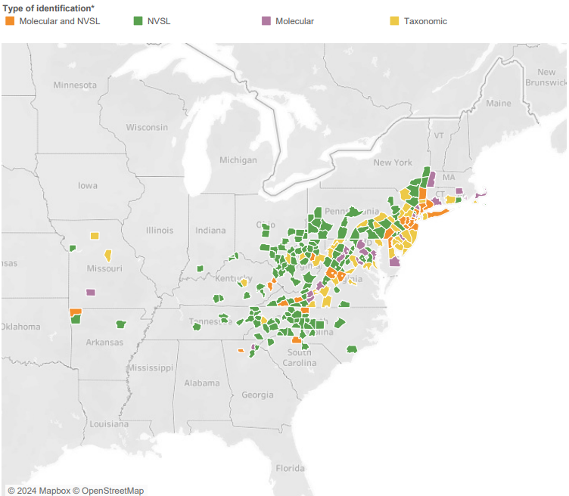
Longhorn Tick and Theileriosis in the USA
Over the winter break a lot of samples were analyzed, lots of new county additions (7 states)
Dog and cat findings have significantly increased
Ohio (from late summer 2024) – 8 counties reporting Theileria positive cattle
Found Theileria in one ALHT in one county
Kansas reported Theileria orientalis Ikeda in imported calves
https://scwds.shinyapps.io/haemaphysalis/
USDA Haemaphysalis longicornis (Asian longhorned tick) Situation Report – March 2025
Notes:
New County additions in Ohio, North/South Carolina, Virginia, West Virginia, Kentucky, and Missouri

Slide 7
Alpha Gal Syndrome (red-meat allergy)
An immunoglobulin E mediated allergy to galactose-α-1,3-galactose (alpha-gal), found in mammalian meat
GI symptoms, malaise, and anaphylaxis
CDC estimates AGS affects ~450,000 Americas
Usually associated with bites from the lone star tick (Amblyomma americanum)
Two new studies have also linked it to bites from Ixodes scapularis (Maine) and Ixodes pacificus (Washington)
Alpha-Gal Syndrome after Ixodes scapularis Tick Bite and Statewide Surveillance, Maine, USA, 2014–2023
Onset of Alpha-Gal Syndrome after Tick Bite, Washington, USA
Notes:
Ixodes scapularis – black legged tick
Ixodes pacificus – western black-legged tick
After increasing AGS surveillance, the Maine CDC received positive alpha-gal–specific IgE laboratory reports on 57 Maine residents in 12 counties from November 2014 to October 2023. The average age of patients was 57 years, 61% were men, and 74% lived in coastal areas.
People should be aware of AGS outside of the establish lone star tick range***

Slide 8
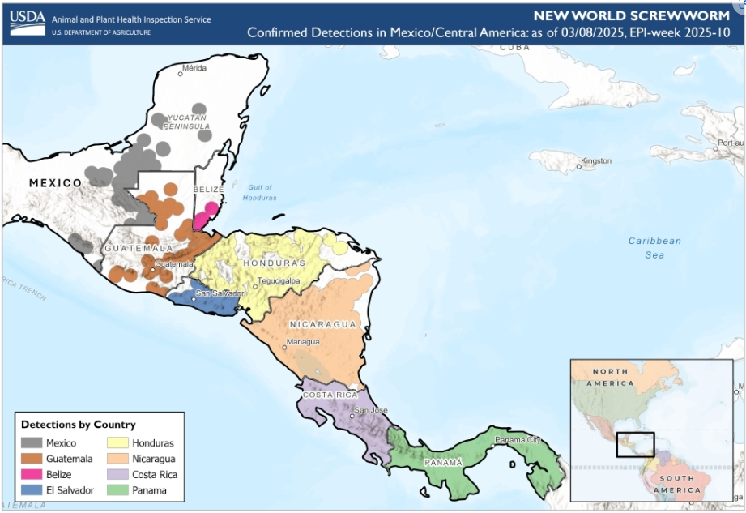
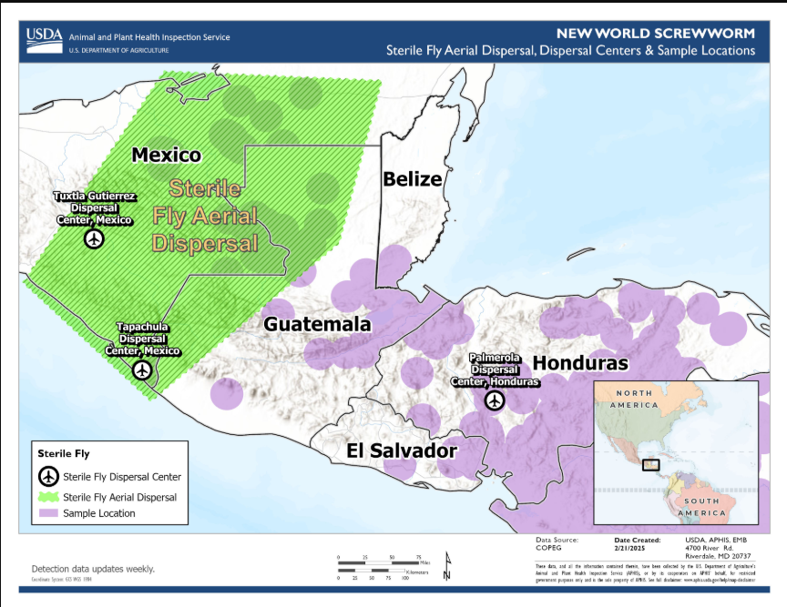
New World Screwworm in Central America and Mexico
NWS has now been found as far north as the Yucatan peninsula
COPEG maps not being updated
Sterile fly release moved to Mexico to try and prevent further northward movement
USDA states that the eradication of NWS in Central America with re-establishment of controls at the Darian gap are the aim of the program
Human cases have now been reported in Mexico, Nicaragua, and Honduras
Vampire bat involvement in spread
COPEG
Notes:
Mexico has reported cases in all five southern regions: Chiapas (169 outbreaks), Campeche (31), Quintana Roo (4), Tabasco(42), and Yucatan(1)
Cases in animals continue increasing, although copeg maps not updated anymore
Since the last update Belize and El Salvador have also reported their first cases of the NSW

Slide 9
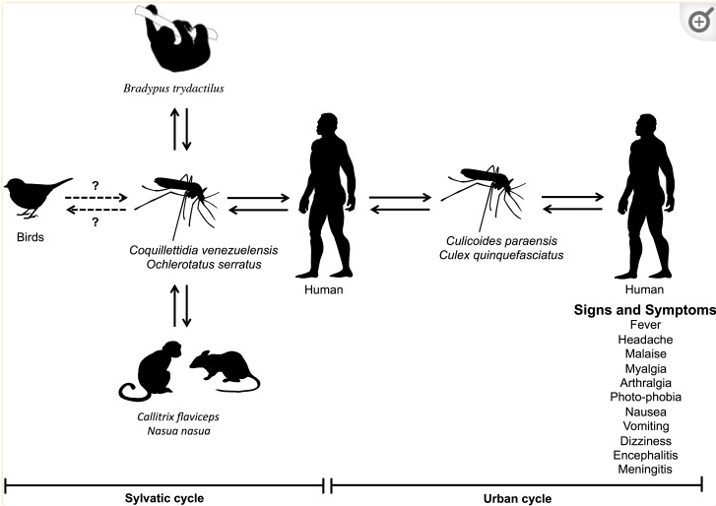
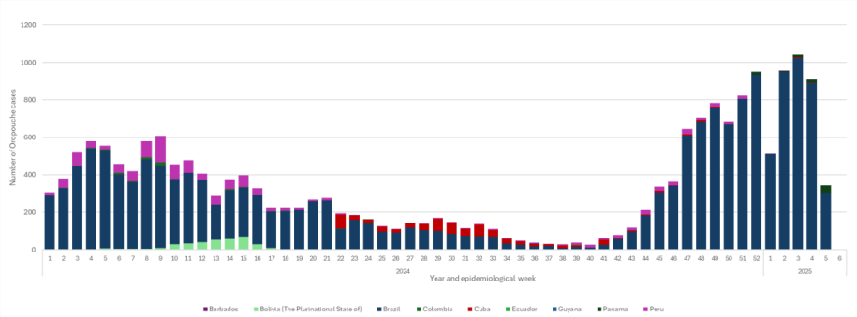
Oropouche virus
PAHO released an epidemiological update on Oropouche virus in the Americas on February 11, 2025
Investigations into vertical transmission in Brazil
OROV detected in semen
Oropouche Virus: Clinical, Epidemiological, and Molecular Aspects of a Neglected Orthobunyavirus
Cuba - OROV activity reporting in seven provinces
Panama – 221 cases, 1 death
Lack of Competence of US Mosquito Species for Circulating Oropouche Virus
2025
Notes:
In 2025, between epidemiological week (EW) 1 and EW 4, there were 3,765 confirmed Oropouche cases reported the Americas Region. Confirmed cases were reported in six countries in the Americas Region: Brazil1 (n= 3,678 cases), Canada (n= 1 imported case), Cuba (n= 4 cases), Guyana (n= 1 case), Panama2 (n= 79 cases), and Peru (n= 2 cases)
2024 in Brazil, there were five confirmed cases of vertical transmission (four fetal deaths and one case of congenital anomaly) and further investigation of fetal deaths, f miscarriages, and congenital
Study evaluated the competence of US vectors, including Aedes albopictus, Culex quinquefasciatus, Culex pipiens, and Anopheles quadrimaculatus mosquitoes. Results with historic and recent isolates suggest transmission potential for those species is low. - However other news reports and one journal article from Cuba from 2024 have suggested that its primarily being spread on the island by Culex Quinquefasicatus

Slide 10
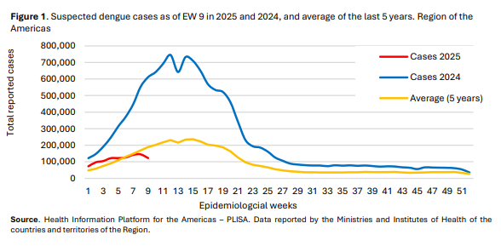
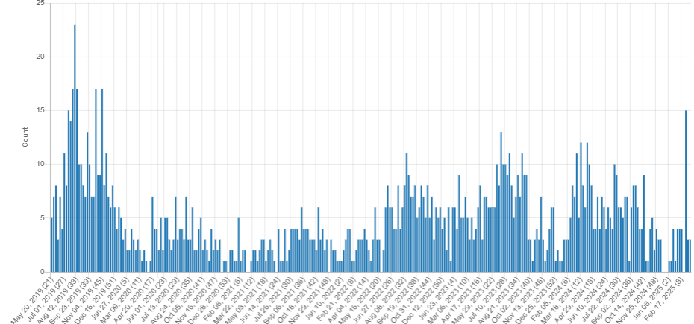
Dengue
PAHO released an epidemiological update on Dengue in the Americas on March 20, 2025
In Asia – Bangladesh, Philippines, Indonesia, and Vietnam have been reporting increasing case counts
CDC HAN Alert – March 2025
WHO Dengue Dashboard – Only up to January 2025
LSD Signals: May 2019 – March 2025
Notes:
In the epidemiological weeks (EW) 9 of 2025, a total of 1,054,336 suspected cases of dengue were reported, resulting in a cumulative incidence of 104 per 100,000 population. This represents a decrease of 65% compared to the same period in 2024 and an increase of 4% compared to the average of the last 5 years
First 9 weeks of 2025 - 1,054,336 suspected cases 361,817 lab confirmed (34%) 1,303 severe dengue cases (0.1%) 342 deaths 0.032% case fatality rate (CFR)
With Brazil reporting the most cases
Certain regions of Philippines are reporting increasing case counts Illioi has reported a total of 942 dengue cases from 1 Jan to 8 Mar 2025, marking an 81% increase compared to the 520 cases recorded during the same period last year [2024].
Bulacan Region - From 1 Jan to 1 Mar [2025], the province logged 4114 dengue cases, a 272% increase compared to the 1107 cases recorded during the same period in 2024. In the past week alone, dengue cases rose by 504, up from 3610 reported between 1 Jan and 22 Feb 2025.
Bangladesh – is around ~1700 cases from the beginning of the year up until Mar 10.

Slide 11
Japanese Encephalitis in Australia
Flavivirus causing encephalitis in humans, neurological disease in pigs and horses
Spread by Culex species mosquitos
Pigs can act as amplifying hosts
Emerged in Australia in 2022 affecting humans and pigs
2025 - Two human deaths reported in Australia
Other human cases in Victoria, New South Wales, and Queensland
2025 – Two piggeries in Queensland, feral swine?
SHIC JE Factsheet – June 2024
Notes:
Japanese encephalitis virus (JEV) is a flavivirus that causes encephalitis in humans mainly in Asia and the western Pacific. The virus also produces neurological disease in pigs and horses and reproductive failure in pigs.
JE virus is transmitted to humans through the bites of infected Culex species mosquitoes, particularly Culex tritaeniorhynchus.
In areas of Asia, JE virus transmission is seasonal. Human disease usually peaks in the summer and fall.
JEV emergence in the United States (and other areas outside of Asia) is a concern due to the presence of competent mosquito vectors and susceptible hosts.
First cases in pigs since 2022.. And some report of JE in feral pigs and fears that they may further amplify and spread the virus.

Slide 12
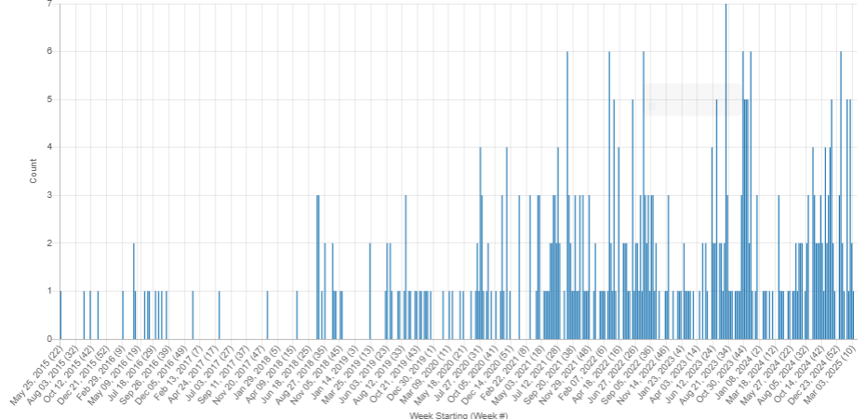
Lumpy Skin Disease
No additional cases of LSD reported in Japan
Initial case reports occurred in cattle in Itoshima city, Fukuoka prefecture
22 total outbreaks reported
Namibia reported LSD cases in the Otjozondjupa Region in June 2024
Has now spread to multiple regions with 1,564 clinical cases and 443 deaths recorded
LSD Signals: May 2015 – March 2025

Slide 13
Scientific Findings
First isolation of the Sindbis virus in mosquitoes from southwestern Spain reveals a new recent introduction from Africa
Potential mechanisms underlying bluetongue virus emergence and spread
Fatal case of imported visceral leishmaniasis in a dog caused by Leishmania infantum in French Guiana
Oz Virus Infection in 6 Animal Species, Including Macaques, Bears, and Companion Animals, Japan
A wolf at the door: the ecology, epidemiology, and emergence of community- and urban-level Rocky Mountain spotted fever in the Americas
Travel-associated international spread of Oropouche virus beyond the Amazon
Equine Encephalomyelitis Outbreak, Uruguay, 2023–2024
Genomic characterization and evolutionary analysis of a Getah virus variant from piglets in central China
Zika virus modulates human fibroblasts to enhance transmission success in a controlled lab-setting
ECDC Chikungunya worldwide overview February 2025
Detection of Bagaza Virus in Europe: A Scoping Review
Ticks jump in a warmer world: Global distribution shifts of main pathogenic ticks are associated with future climate change

Slide 14
Scientific Findings
Emergence of a natural reassortant between Shamonda and Sathuperi viruses of the species Orthobunyavirus schmallenbergense in Japan
Addressing the emerging threat of Oropouche virus: implications and public health responses for healthcare systems
Human neuroinvasive Toscana virus infections in Italy from 2016 to 2023: Increased incidence in 2022 and 2023
Epidemiological analysis and potential factors affecting the 2022–23 Crimean-Congo hemorrhagic fever outbreak in Iraq
Early insights of dengue virus serotype 3 (DENV-3) re-emergence in São Paulo, Brazil
Human Infection with a Novel Tickborne Orthonairovirus Species in China
Eilat virus isolated from Culex univittatus mosquitoes from the Namibian Zambezi Region influences in vitro superinfection with alpha- and flaviviruses in a virus-species-dependent manner
Two Human Infections with Diverse Europe-1 Crimean-Congo Hemorrhagic Fever Virus Strains, North Macedonia, 2024
Concurrent severe fever with thrombocytopenia syndrome virus outbreaks on multiple fox farms, China, 2023
Prevalence, Isolation, and Molecular Characterization of Severe Fever with Thrombocytopenia Syndrome Virus in Cattle from the Republic of Korea
CDC – Tularemia — United States, 2011–2022

