Slide 1
Community for Emerging and Zoonotic Diseases Identifying emerging risks through collective intelligence
CEZD – CAHSS Small Ruminant Network Update
26 March 2025
www.cezd.ca

Slide 2
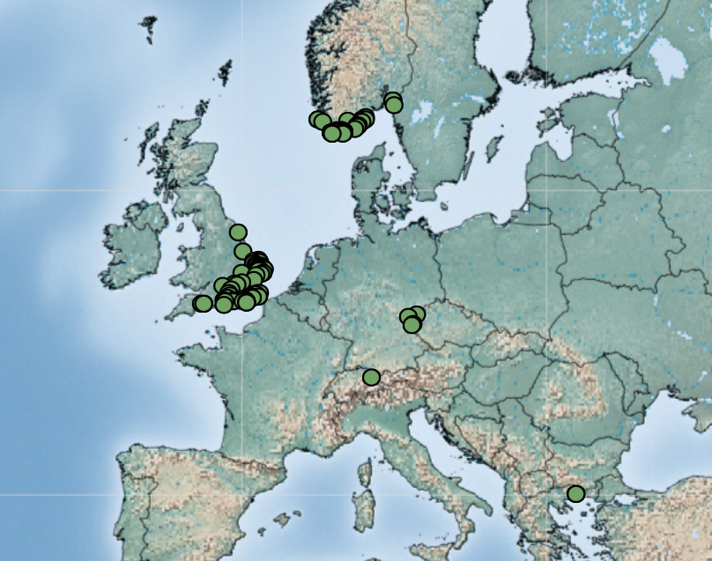
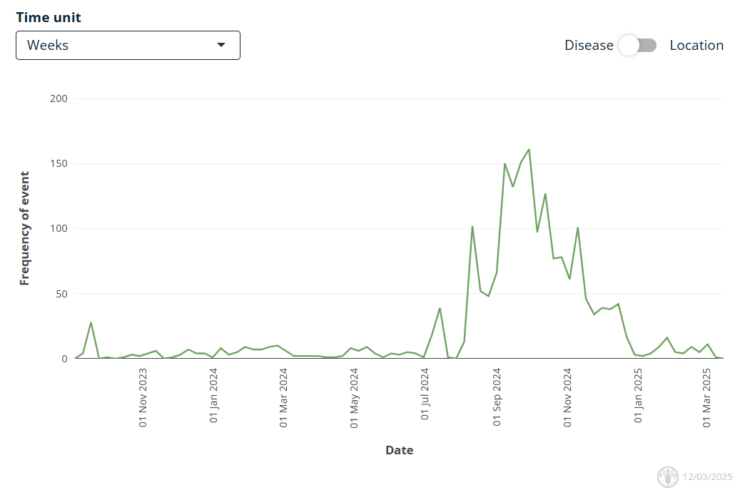
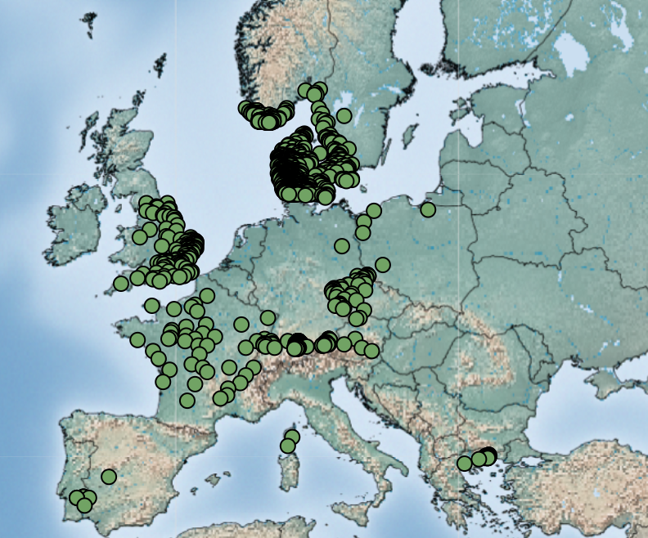
Bluetongue virus (BTV-3) in Europe
First reported Sept 5, 2023 in the Netherlands
Source of infection has never been identified
Continued reports of cases throughout the winter but significant decrease in cases now
BTV-3 Jan 1, 2025 – March 25, 2025
Empres-Plus
BTV-3 Sept 1, 2024 – Dec 31, 2024
Notes:
BTV serotype 3 is a reportable disease in Canada
We have been reporting on the outbreaks of Bluetongue virus serotype 3 in Europe since the fall of 2023. This outbreak started in the Netherlands in the fall of 2023 and spread rapidly across Europe in 2024 affecting 17 countries and 10s of thousands of farms. The source of the infection has never been identified.
While there has been a very significant decline in the number of cases detected across Europe this winter, it is concerning that cases continue to be reported in the winter months, during a time when we would normally consider midge activity to be minimal.
What is most important about this event is the rapidity with which the disease spread through a vulnerable population, and its detection during the winter when it would not normally be found. With the impacts of Climate change, Canada should examine our own vulnerabilities to the strains of Bluetongue in North America.

Slide 3
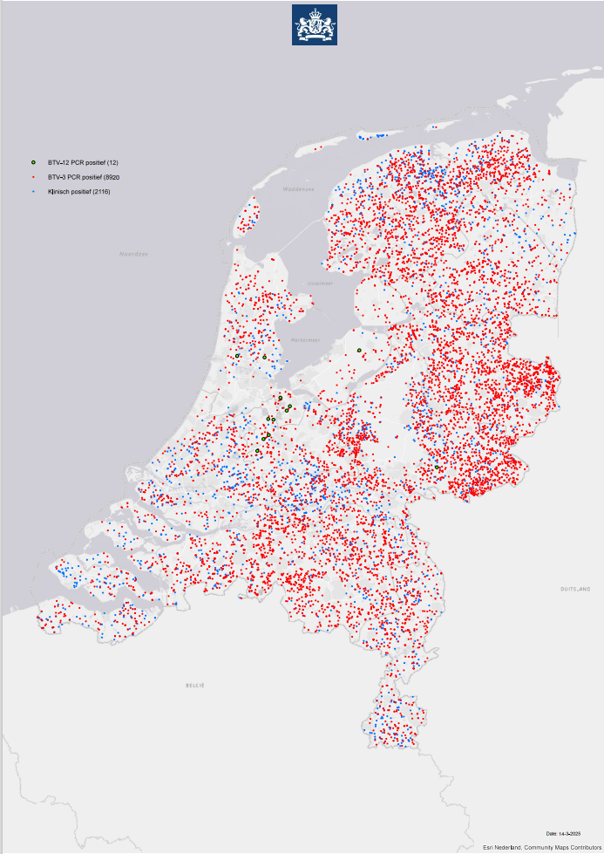
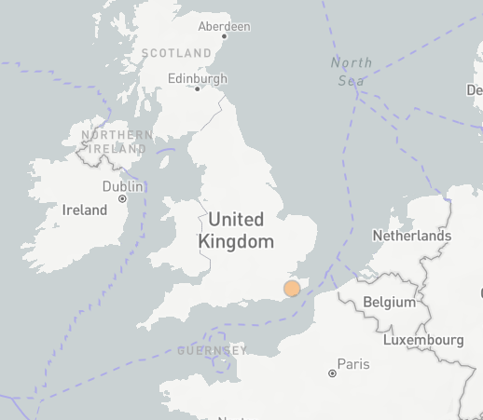
Bluetongue virus (BTV-12 & 4) in Europe
BTV-12
The Netherlands reported their first cases of BTV-12 on October 10, 2024, in a sheep on a farm in Kockengen and in a cow and her calf on a farm in Harmelen
Netherlands still only reporting 12 cases of BTV-12
England BTV-12 for the first time on February 2, 2025
BTV-4
Slovenia reported a reoccurrence of BTV-4, previously reported in December 2016
Three cases have been reported in cattle in northern Slovenia
Notes:
Bluetongue serotype 12 was also been detected in Europe for the first time in the fall of 2024, in the Netherlands last October and they have reported a total of 12 cases so far and England reported BTV 12 for the first time in February of this year on a farm with 15 cows, 1 positive for BTV 12 and three positive for BTV3
It is unknown how BTV-12 was introduced to the Netherlands, the serotype is common in other parts of the world, reported to WOAH by Israel (2010) and Australia (2015). However, it is commonly found in African countries, as is serotype 3.
The Netherlands is retrospectively examining their BTV-3 samples for evidence of BTV-12. Though it seems to be less virulent than BTV-3, the case in the UK had no clinical signs.
Unclear how these different serotypes keep being identified in the Netherlands [BTV-3 (2023), now BTV-12 (2024), and previously BTV-6 (in 2008)]. Is their diagnostics capacity better and its just going undetected in certain countries, or is it another transmission pathway directly into the Netherlands?
BTV-4 has recurred in the Slovenia after being absent for 9 years.

Slide 4
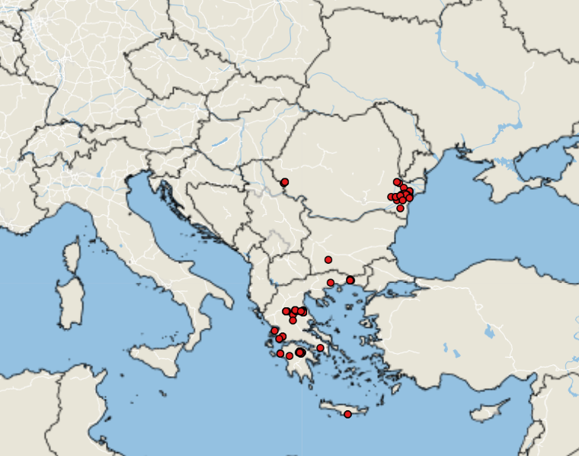
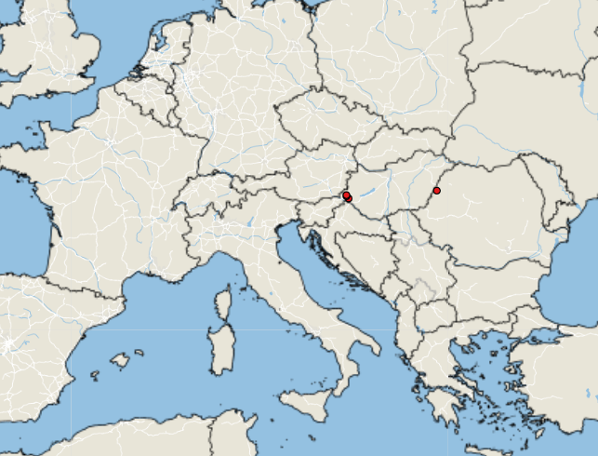
Peste des petits ruminants - Europe
June – December 2024
Greece (87), Romania (68), Bulgaria (1)
Original source uncertain
Primary risk factor is movement of live animals
January 1 to March 25 2025
Hungary (3), Romania (1)
Source of jump to Western Hungary was legally imported sheep from Romania
Notes:
Peste des petits ruminants is a reportable disease not present in Canada.
There have been an unexpected increase in cases of PPR in Eastern Europe over the past year.
Between June and December of 2024, Greece and Romania had 87 and 68 cases respectively, whereas Bulgaria had only 1 case.
Since January 1st, 2025, there have only been 4 cases, with 3 in Hungary and 1 in Romania. The cases in Hungary were associated with legal animal movements.

Slide 5
Sheep and Goat Pox in Europe
Ongoing outbreaks in Bulgaria and Greece (started early September 2024)
66 additional cases since last meeting, slow down in numbers seen
No other countries reporting outbreaks

Slide 6
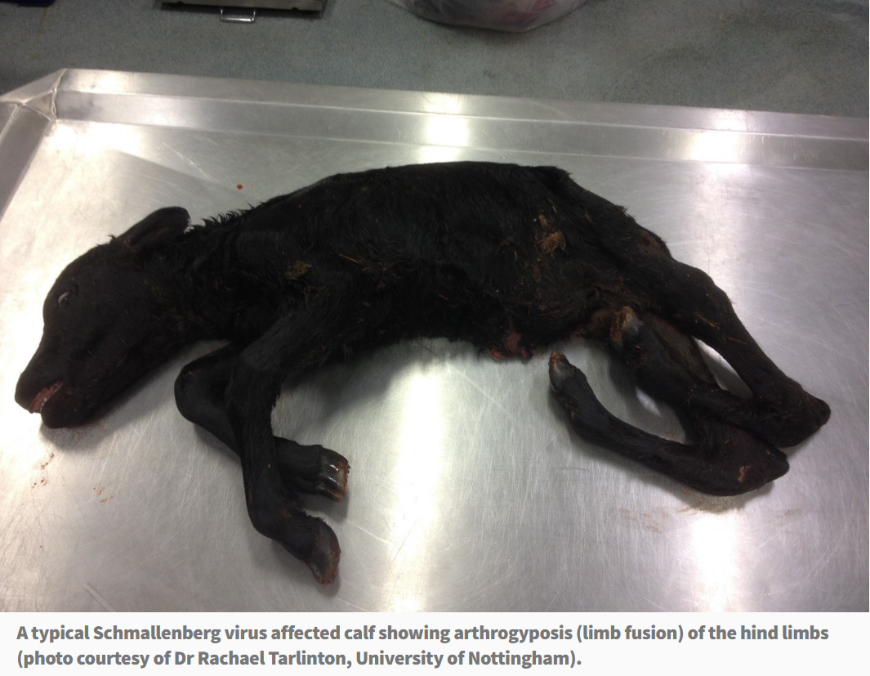
Schmallenberg virus in Europe
Farmers fear being 'wiped out' if any more diseases strike (Scotland)
Ireland and Scotland reporting cases of SBV
Not notifiable, many cases may be going unreported
Spread by Culicoides, may be experiencing increase in reports as with BTV
AHS - Current News (agriculture.gov.ie)
Notes:
Schmallenberg virus can affect cattle, sheep, and goats. Is transmitted by biting midges, and can cause fever, reduced milk yield, and in pregnant animals, abortions or birth defects
It was first detected in Germany in 2011 and then spread across Europe..

Slide 7
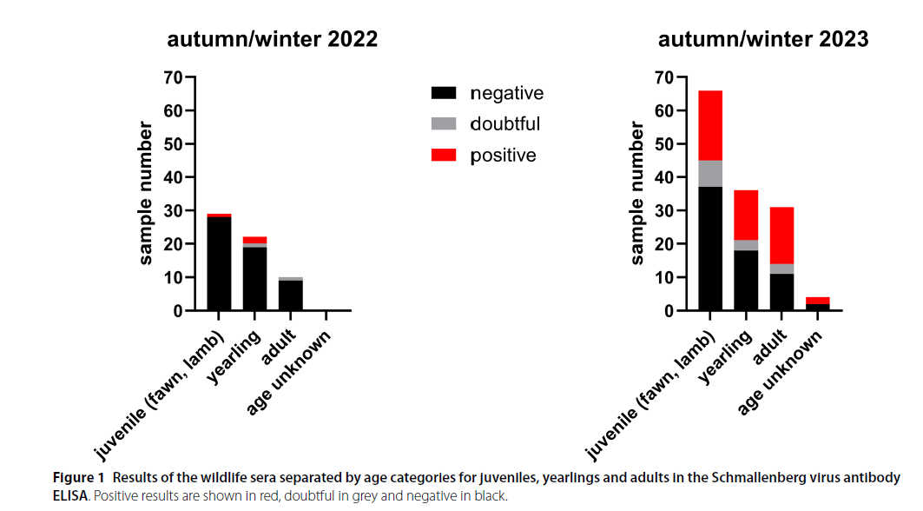
Extensive Schmallenberg Virus circulation in Germany, 2023
Serosurveillance of wild ruminants for BTV and SBV
All animals seronegative for BTV
In 2022, seroprevalence in tested animals was 4.92% (n=61)
Red Deer and Roe Deer
In 2023, 40.15% of the animals tested positive (n=137)
Red Deer, Roe Deer, Mouflon and unknown species
Notes:
Schmallenberg virus can affect cattle, sheep, and goats. Is transmitted by biting midges, and can cause fever, reduced milk yield, and in pregnant animals, abortions or birth defects
It was first detected in Germany in 2011 and then spread across Europe.
Serosurveillance over 2 years shows variability between the years, which matches the waves of infection that seem to occur in Schmallenberg in farmed ruminants.

Slide 8
The first report of Schmallenberg virus seroprevalence and associated risk factors in cattles in northern Algeria | Tropical Animal Health and Production
Algeria has also recently reported first seroprevalence findings in cattle
A seroprevalence of 44% (CI95%, 39 – 49.2%) was revealed in dairy cattle in Northern Algeria

Slide 9
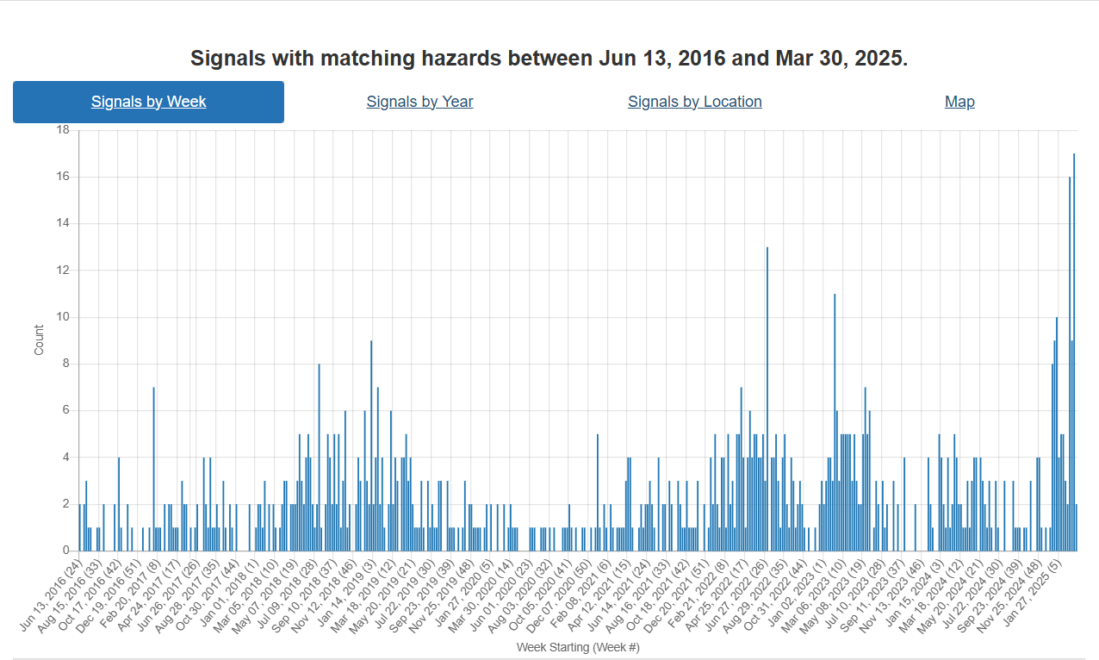
Foot and Mouth Disease – Hazard Trend
Hungary + Slovakia
COVID
Indonesia
SAT-2
Middle East
Germany

Slide 10
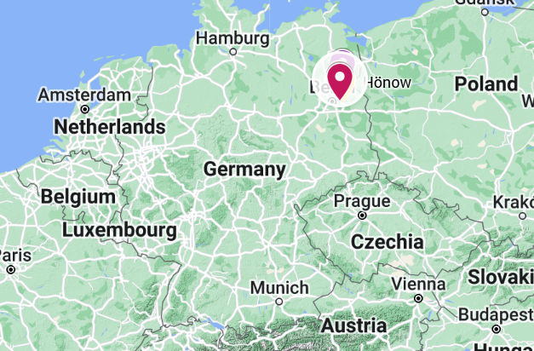
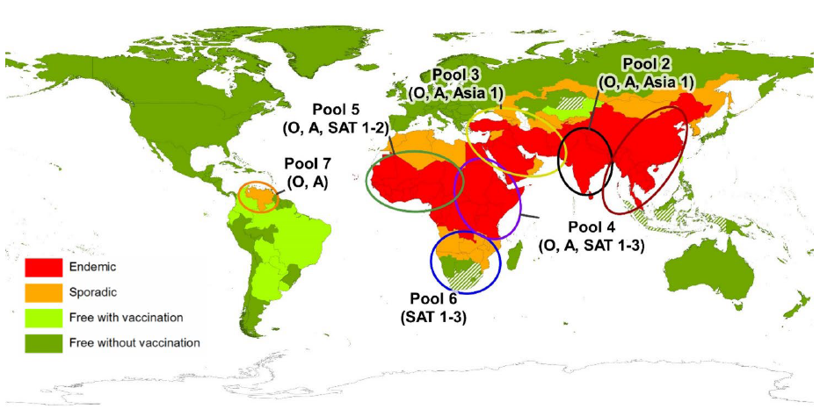
Foot and Mouth Disease in Germany
Germany has reported a case of FMD in water buffalo in Brandenburg (Jan 10)
First occurrence since 1988
Three buffalo died and the rest of the herd (11) were culled
Identified as serotype O – vaccines available in German FMD antigen bank
Closest to strain from Türkiye in Dec 2024
Vaccine was made but was not used
Source of infection is still unknown
Backyard farm “organic”, feed hay from own fields
No trade within epidemiologically significant period
Foot-and-mouth disease - European Commission
Global Distribution of FMD – Merck Veterinary Manual
Notes:
Germany reported an outbreak of FMD in water buffalo in Honow, outskirts of Berlin, on Friday (Jan 10th).
This is the first report of FMD in the country since 1988 (which occurred in lower saxony). And the last outbreak in Europe was reported in Bulgaria in 2011. FMD remains endemic in Turkey, the Middle East, Africa, parts of Asia and South America.
In this event - three water buffalo in Honow have died and the entire herd (remaining 11 buffalo) were culled as a precautionary measure. You can see on the map on the top right where this is in Germany.
The serotype has been identified as O – which is closely related FMD viruses are found in the Middle East and Asia, - You can see from the bottom right image the different pools for FMD worldwide and serotype O is present in all of them except for pool 6 which is in southern Africa. But the closest in proximity to Europe would be those circulating in the middle east (pool 3)
The sequence is closest to strains from Turkiye in December 2024 https://food.ec.europa.eu/animals/animal-diseases/diseases-and-control-measures/foot-and-mouth-disease_en but has also been found in India, Nepal and Iran
The exact origin and route of entry is still unknown, and it is interesting that it was detected in water buffalo and its listed as a backyard farm
But it also shows that the risk of introduction of this virus into a susceptible population can happen anytime.

Slide 11
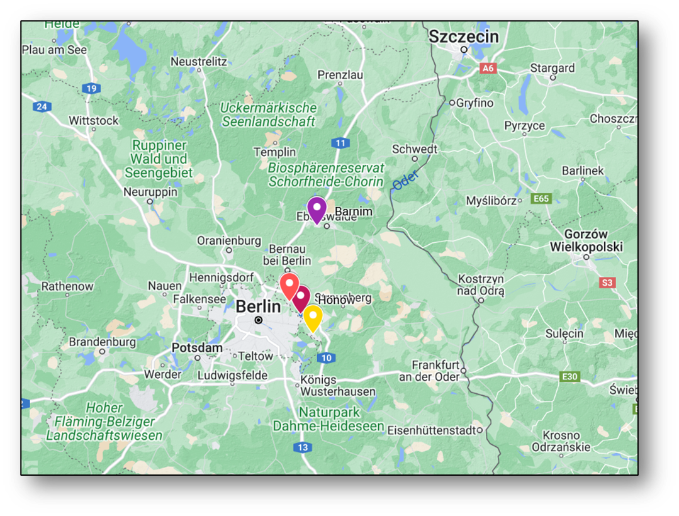
Response
Immediate transportation ban (5 days)
All susceptible livestock within a 1km radius culled
~200 pigs in Ahrensfelde culled, all tested negative
3km protection zone
10km surveillance zone
Sampling of all establishments within the 10 km Zone is complete, all results have been negative
All clinically normal
DEFRA FMD Outbreak Assessment
Notes:
Immediate transportation ban (5 days) in Brandenburg
- all susceptible livestock within a 1km radius would be culled as a precaution and this includes a pigs farm with ~ 200 pigs in Ahrensfelde, near where the outbreak was detected.
- Additionally, 55 sheep and goats and 3 cattle from a farm in OderSpree are to be slaughtered on 13 January as the farm had obtained hay from the farm in Hönow where the outbreak occurred but none of the animals have shown signs of infection. The sampling of all establishments within the 10km Restriction Zone (RZ) is ongoing, but so far results have been negative. There is also a hunting ban in place in the restriction zone and berlins two zoo’s have closed.
- Netherlands have implemented a national ban on the movement of veal calves (unless they are going to slaughter) and a ban on visitors to veal farms because there have been more than 3,600 calves transported from Brandenburg to the Netherlands since 1 December. These calves are located on more than 125 veal calf farms spread across the Netherlands.
Re-testing of samples which tested negative for bluetongue for FMD as bluetongue can be a differential diagnosis for FMD
Protection Zone: means a zone where specific biosecurity and sanitary measures are implemented to prevent the entry of a pathogenic agent into a free country or zone from a neighbouring country or zone of a different animal health status.

Slide 12
Response
55 sheep and goats and 3 cattle from a farm outside the 10 km radius slaughtered as they had purchased hay from the index site
all clinically normal and tested negative
Goats (Barnim) with clinical signs tested negative on PCR and serology
Foot and Mouth Disease | Friedrich-Loeffler-Institut
WAHIS
DEFRA FMD Outbreak Assessment
Notes:
55 sheep and goats and 3 cattle from a farm in OderSpree (Yellow marker) were slaughtered on 13 January as the farm had obtained hay from the farm in Hönow where the outbreak occurred but none of the animals have shown signs of infection and have since tested negative.
- Goats in Barnim (the purple marker on the map) had clinical signs but were PCR and antibody negative

Slide 13
Response
Hunting ban put in place in the 10 km zone
Berlins zoos closed
Tested susceptible species
Netherlands ban on veal calves from Brandenburg
>3,600 imported from Brandenburg since December 1) to ~120 farms – all tested
Netherlands retesting samples tested for bluetongue, to date all negative
Thousands of samples collected from farmed and wild animals – all negative
German Presentation to EFSA end of February
DEFRA FMD Outbreak Assessment
Notes:
There is also a hunting ban in place in the restriction zone and berlins two zoo’s have closed.
- Netherlands have implemented a national ban on the movement of veal calves (unless they are going to slaughter) and a ban on visitors to veal farms because there have been more than 3,600 calves transported from Brandenburg to the Netherlands since 1 December. These calves are located on more than 125 veal calf farms spread across the Netherlands.
Re-testing of samples which tested negative for bluetongue for FMD as bluetongue can be a differential diagnosis for FMD

Slide 14
Foot and Mouth Disease - Germany
Germany has regained freedom without vaccination for most of the country
Controls still in place in restricted zones
Import restrictions remain in place for Canada and many other countries
Disease Freedom from FMD

Slide 15
FMD Hungary – Reported March 6, 2025
Presentations - European Commission

Slide 16
Foot and Mouth Disease - Hungary
Index Case:
Dairy farm ~1400 animals
In Contact
‘Fattening farm’ ~370 animals
Animal movements and Daily feed movements between the sites ~3km away (same owner)
Clinical signs started March 3rd
Loss of appetite and water consumption
March 4, 2025
Same clinical signs, changed moldy bedding
March 5, 2025
Fever, vesicles in mouths, on muzzles, coronary bands and interdigital spaces
80% of heifers affected
March 6th, 2025
Confirmation
Control Zones established
72-hour movement ban
Estimated date of infection 27-28 February
Notes:
In contact site had the same owner, feed movement between sites daily, animal movement between sites

Slide 17
March 8th
Contact holding animals euthanized
March 9 – 15
Euthanizing index site animals
Movement restrictions extended to March 12
Movement for direct slaughter allowed, but no other movements permitted until March 17th
Presentation - Foot and Mouth disease in Hungary
Presentation - Foot and Mouth disease - EUVET mission to Hungary

Slide 18
FMD Hungary
Carcass disposal at site ~30 km away
Deep Burial
Nearest rendering facility 150 km away

Slide 19
Tracing
Notes:
There are a lot of contacts being traced…in particular 35 linked by animal byproducts transport (assumption that ABP stands for animal byproducts)

Slide 20
FMD Hungary
The Hungarian National Reference Laboratory has identified the serotype of the virus:
O serotype
Its sequence shows the highest similarity with a strain isolated in Pakistan in 2017-18 (98-99%)
The subtype of the strains is FMDV/O/ME-SA/Pan-Asia2/ANT-10
The full analysis by the European Union Reference Laboratory is ongoing.

Slide 21
Slovakia – March 21, 2025
3 dairy farms
1311 cattle, 3 cases
790 cattle, 5 cases
670 cattle, 4 cases
(1699 Dairy cattle, 501 calves, 492 heifers, 79 bulls)
Control measures placed on entire country
WAHIS

Slide 22
Presentations - European Commission

Slide 24
Assuming they are vaccinating animals against Serotype O, but serotype still pending

Slide 25
FMD cases globally (since last meeting Dec 18)
Europe
Germany 1 (O)
Hungary 1 (O)
Slovakia 3 (?)
Asia
South Korea 5(?)
China 1 (O)
Indonesia 2 (O)
Middle East
Israel 3(O + ?)
Iraq 2(?) underestimate
Africa
Tunisia 29 (O)
South Africa 6 (SAT-2)
Libya 4(O)
Algeria 2(O)
https://empres-i.apps.fao.org/general
Notes:
Most cases have been within endemic areas, the two real outliers are Germany and Hungary.
Iraq only has two cases in the Empressi data, but news reports suggest there are many more cases than 2, notes in WOAH report indicate that during the last vaccination campaign some owners refused vaccination, which may explain the ongoing cases now.
South Korea has only 1 case on the map, but at least 5 cases have been reported in the news

Slide 26
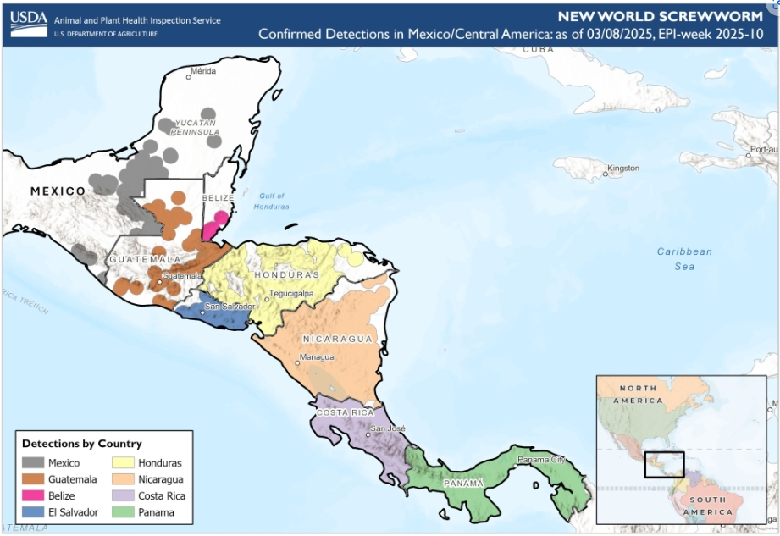
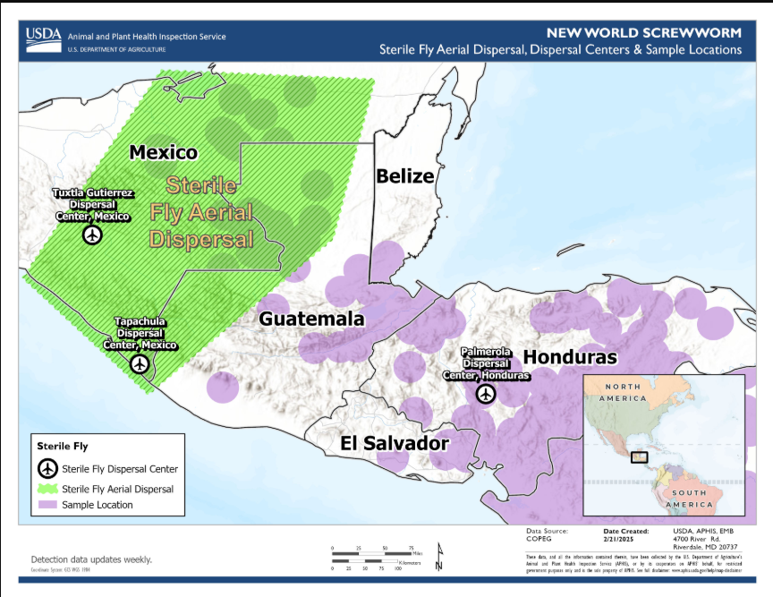
New World Screwworm in Central America and Mexico
NWS has now been found as far north as the Yucatan peninsula
COPEG maps not being updated
Sterile fly release moved to Mexico to try and prevent further northward movement
USDA states that the eradication of NWS in Central America with re-establishment of controls at the Darian gap are the aim of the program
COPEG

Slide 27
Industry Notice – Saskatchewan cattle herd declared infected with bovine tuberculosis - inspection.canada.ca
Investigation status as of 2025-03-13
The depopulation of the infected herd is in progress. Reactor animals identified during live animal testing will be slaughtered first for postmortem inspection and laboratory testing.
The CFIA has started the process for animals and herds connected to the infected herd. This will include:
the testing of herds that have been in contact with infected herd,
the tracing of animals that left the infected herd in the last 5 years and the testing of implicated herds as required
the tracing of animals that provided animals to the infected herd in the last 5 years and the testing of implicated herds as required,
Notes:
Strain of bovine TB identified
Laboratory culture results from the November 29, 2024 infected animal found a strain that has never been identified in animals or humans in Canada, and the origin of the strain is unknown. It is not closely related to any of the recent strains in Western Canada.

Slide 28
Bovine Tuberculosis in the USA
Michigan
confirmed a case of bTB in a beef herd from Alcona County (located in Modified Accredited Zone)
identified during routine surveillance
first case of bTB identified in Michigan since 2022 and Michigan’s 83rd cattle herd to be found with bovine TB since 1998
South Dakota
confirmed multiple cases of bTB in a cow/calf herd in Kingsbury County, identified through traceback efforts on a steer from a Hamlin County feedlot that tested positive in October 2024
traceback efforts continue to track animals sold from the Kingsbury herd over the past five years to prevent further spread of the disease

Slide 29
Scientific Findings
Presentations - European Commission
Acute Q Fever Patients Requiring Intensive Care Unit Support in Tropical Australia, 2015–2023 - Volume 31, Number 2—February 2025 - Emerging Infectious Diseases journal – CDC
Neuropathology, pathomechanism, and transmission in zoonotic Borna disease virus 1 infection: a systematic review

