Slide 1
Community for Emerging and Zoonotic Diseases Identifying emerging risks through collective intelligence
CEZD – CAHSS Small Ruminant Network Update
18 September 2024
www.cezd.ca

Slide 2
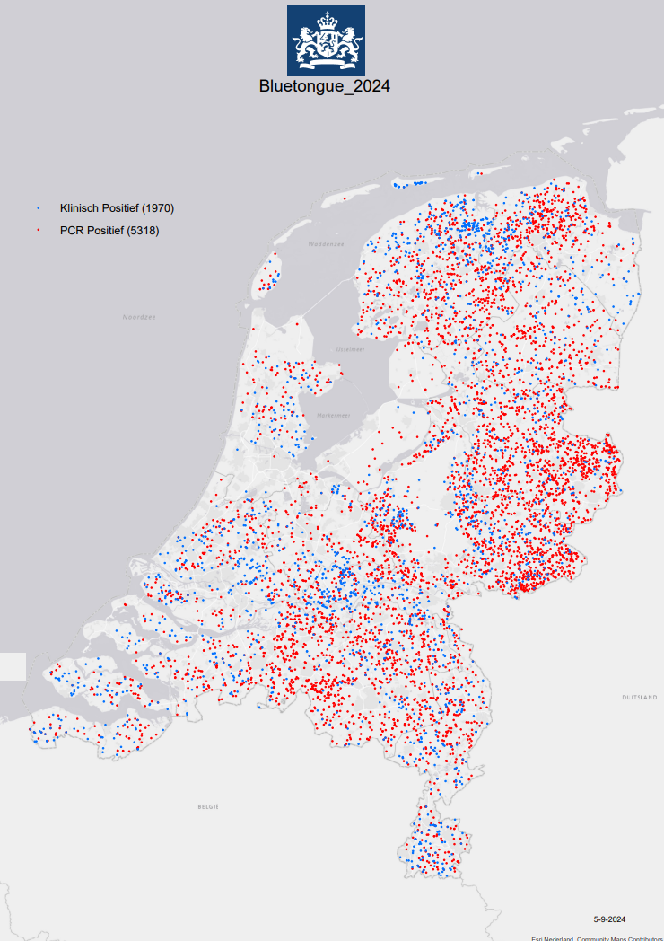
Bluetongue virus (BTV-3) in Europe
Netherlands
First reported Sept 5, 2023
Most recent reports
PCR BTV-3 positives – (5318)
Clinically positive - 1970 (no PCR)
Spread through entire country, all 12 provinces
Cases in cattle and sheep
Two vaccines for BTV-3 now available
Spanish and German
The impact of the bluetongue serotype 3 outbreak on sheep and goat mortality in the Netherlands in 2023
Notes:
Netherlands first reported the outbreak of BTV-3 in Sept 2023
For 2024, as of Sept 5, recent counts show 1970 clinically positive and 5328 PCR positive cases (Totaling to ~ 7200 cases)
Cases have been reported in both cattle and sheep, earlier cases also reported one in a dog and some in alpacas/lamas
Two vaccines became available earlier this year - one is Spanish and the other German
However even with the vaccination still appears to be spreading.
There is also a recent journal article published on the impact BTV-3 has had on sheep and goat mortality in the Netherlands. Linked in slide.
Moving on to other European countries that have reported BTV-3 outbreaks

Slide 3
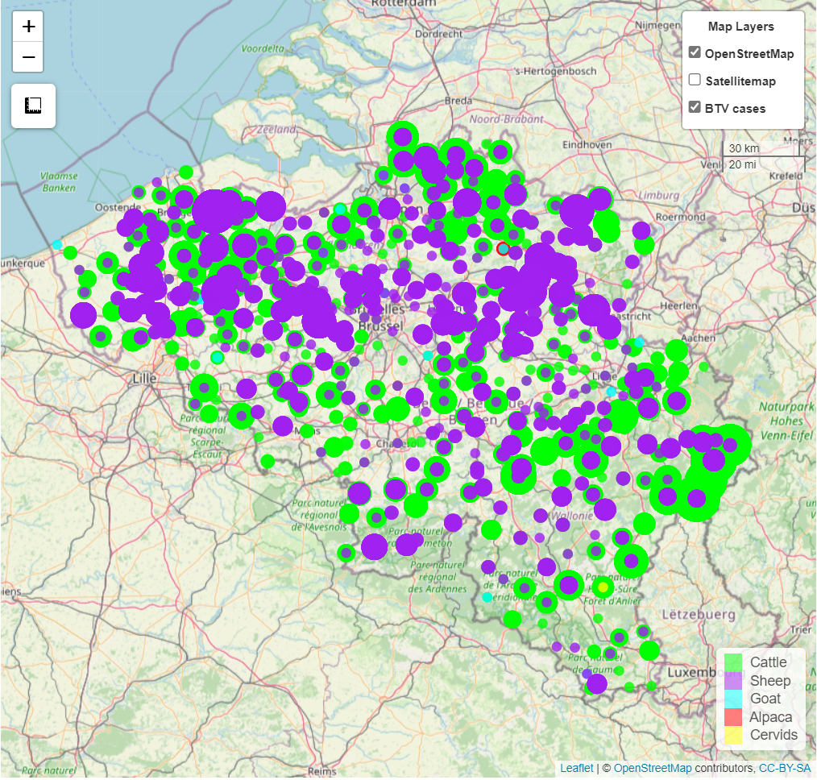
Bluetongue virus (BTV-3) in Europe
Belgium
October 10, 2023 case of BTV-3 in sheep in Merksplas
Dashboard now shows cases across entire country
~1,192 farms affected now, ~3x more than three weeks ago
Germany
Oct 13, 2023 cases of BTV serotype 3 in Kleve
Cases in both cattle and sheep
Not many WOAH reports, but news media suggest widespread (only 1 state, Berlin, unaffected)
Notes:
Belgium had reported 1 additional case in late April 2024 for a total of 8, but now looking at their dashboard, it seems that cases are reported across the entire country. Recent media reports suggest there are 1,192 farms affected (which is 3 times more than what was reported ~3 weeks prior)
Germany has reported additional cases in both cattle and sheep, but totals differ across different reporting systems. There have not been many WOAH/WAHIS reports, but news media suggests it is widespread across the country, with only the state of Berlin currently unaffected.

Slide 4
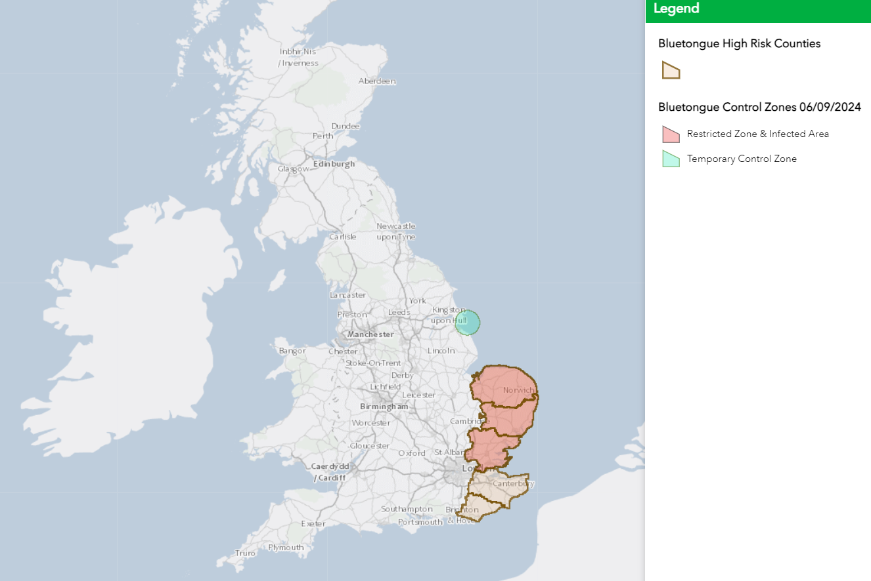
Bluetongue virus (BTV-3) in Europe (*new country)
UK
Nov 10, 2023 cases of BTV serotype 3 in cattle in Kent
Reoccurrence in late August 2024
As of September 8, 34 total affected premises in Norfolk, Suffolk and Essex
France *
First case on July 30, 2024
Most recent WOAH report shows 185 outbreaks in both sheep and cattle
Vaccine distribution planned, 6.4 million doses
UK Interactive BTV Map
Notes:
UK:
Last update we discussed the UK Risk assessment that looked at the incursion of both BTV-3 and BTV-8 into the country. The UK has reported cases of BTV-3 in 2023, but seemed to have gotten it under control through the winter.
One of their conclusions was - a very high probability of a new introduction of BTV-3 into livestock into great Britain through infected midges being blown over from northern Europe – however with a high uncertainty.
The UK has now reported a reoccurrence of the virus, as of September 8, 2024 there are a total of 34 affected premises, and three vaccines have been given special permission for use under licence in the UK
The map on the right links to the UK dashboard for BTV cases along with the established zones.
France:
Since the initial reports of BTV-3 in France in late July 2023, the country has reported a total of 185 outbreaks of BTV-3 in both sheep and cattle, with 122 of the outbreaks occurring over the last week; the outbreaks are still localized to north eastern France, along France’s borders with Belgium and Luxembourg
France is distributing 6.4 million doses of BTV-3 vaccine to the most impacted regions

Slide 5
Bluetongue virus (BTV-3) in Europe (*new country)
Luxembourg*
First case August 2, 2024
As of August 21, 339 animals, including 236 cattle, 99 sheep, and four goats, across 180 farms in Luxembourg are currently infected
Vaccination underway since August 9, 2024
Denmark*
First cases of BTV-3 confirmed August 9 2024
Sheep flock in Tonder
Establishment also held cattle but no symptoms so far
Total outbreaks now at 17
Switzerland*
First cases of BTV-3 August 28/29 2024
Three cases (one sheep in Solothurn and two sheep on a farm in Jura)
Currently no approved vaccine against BTV-3 in Switzerland
Norway* - confirmed as BTV-3
Two sheep in Kristiansand (southern Norway)
blown in from Denmark?
Czech Republic* - confirmed as BTV-3
Two initial outbreaks close to the German border
Notes:
Shortly after the initial France reports, Luxembourg reported its first outbreak of BTV-3. Since the initial detection on August 2, 2024, a total of 339 animals (236 cattle, 99 sheep, and 4 goats) have tested positive for BTV-3 across 180 farms. A vaccination campaign was initiated on August 9, 2024, with 50,000 doses distributed to veterinarians and another 190,000 additional doses ordered.
Denmark first cases of BTV-3 were reported in a sheep flock in Tonder, which also held cattle (not clinical). BTV-3 was confirmed on 9th August 2024. Current total of outbreaks reported in Denmark is 17, however media reports also suggest it is widespread across the country.
Switzerland has also recently reported their first case of BTV-8 in one cattle in Vaud.
Norway initial reports of 2 sheep in Kristiansand (southern Norway), serotype has been confirmed at BTV-3 - could it have blown in from Denmark?
Cezch Republic initial reports also confirmed at BTV-3. One case in a Ram, and four cases in sheep, close to the German border

Slide 6
Bluetongue virus (BTV-3) in Europe (*new country)
Austria*
One case reported on September 13, 2024, in cattle
Close to borders of Switzerland and Germany
Sweden
Reoccurrence of BTV-3
Last report in 2009
Two cases now reported in cattle in the south of the country
From Denmark?
Notes:
Austria has also reported its first case of BTV-3, one case was reported on September 13, with a start date of Sept 10, in cattle in Bergenz, close to the borders of Switzerland and Germany.
Sweden reported cases of BTV-3 on September 13. A reoccurrence of the virus, which was previously reported in February 2009. Two cases were reported in the south of Sweden, one in dairy cattle and the other in beef cattle. Could it have again blown over from Denmark?
There has been a lot of BTV-3 activity in Europe lately, with 7 countries now reporting first instances of the virus, and Sweden and the UK reporting reoccurrences. Hopefully with some of the vaccination efforts as well as the upcoming fall and cold weather it will decrease.

Slide 7
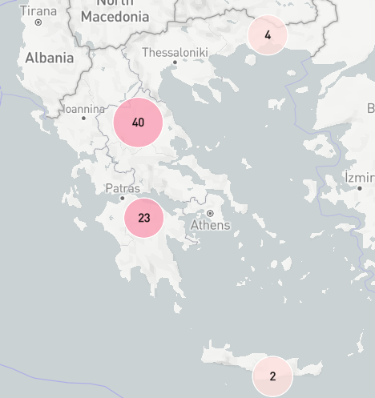
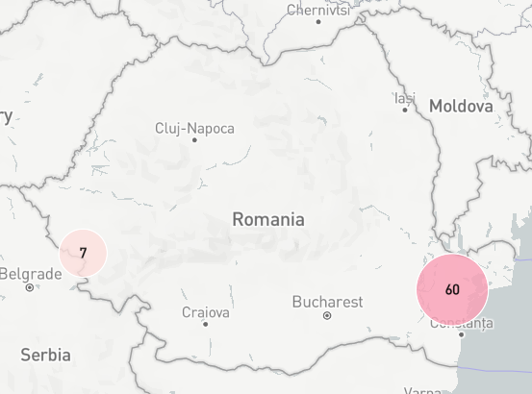
Peste des petits ruminants - Europe
Romania
First case detected on July 15, 2024
As of September 12, 2024 – 67 outbreaks reported
Majority of outbreaks located in the east of the country, some on the west near border with Serbia
236,023 animals exposed, 5,656 cases, 4,944 deaths, and 230 killed/disposed of
Greece
First case detected on July 8, 2024
As of September 12, 2024 – 69 outbreaks reported across the country
29, 463 animals exposed, 4,265 cases, and 486 deaths reported
No official word on source of outbreaks
Molecular typing of the isolates would give us more information
Notes:
Now moving unto Peste des petits ruminants – a viral disease that affects sheep and goats. Pigs and cattle can be infected but do not show clinical signs and cannot transmit the virus.
PPR is currently present in North, Central, West and East Africa, the Middle East, South Asia and Southern Europe. In Europe outbreaks were previously reported in Turkiye (in late 2023, reported as resolved in Feb 2024) and in Bulgaria (last WOAH report cases in 2018). But now it has spread to Greece and Romania.
Greece:
Peste des Petits Ruminants (PPR) was detected for the first time in Greece on July 8, 2024 in Kastraki in the region of Thessaly and Central Greece
As of September 12, 2024 that have been 69 outbreaks reported across the entire country (in the image below you can see there are outbreak in the north, central and south regions of the country, along with the island of Crete)
It appears to have spread widely via the movement of breeding stock from the originally infected farm. And
According to WOAH, there are 29, 463 animals exposed in these outbreaks with 4,265 cases and 486 deaths reported
Romania:
A week after the initial Greece detection, the first outbreak of PPR was detected in Romania on 15 July 2024 in a sheep fattening farm in Tulcea near the Black Sea coast
As of September 12, 2024 – there have been 67 outbreak reported in the country, with the majority reported in the east of the country, and 7 in the west close to its border with Serbia
According to WOAH, there have been 236,023 animals exposed with 5,656 cases and 4,944 deaths, along with 230 that were killed and disposed of
There is no word yet on the source of the outbreaks in Greece and Romania
However, there have been concerns that PPR in Romania came from Turkey via the illegal movement of lambs to satisfy market needs. Molecular typing of the PPR isolates from Greece / Romania would give us more information.

Slide 8
Peste des petits ruminants - Europe
Scientific Findings/Reports
Empirical and model-based evidence for a negligible role of cattle in peste des petits ruminants virus transmission and eradication
PPR in Bulgaria June 2018 (publishing.service.gov.uk)
Introduction risk to UK increased from negligible to very low
Canada
Is there/What is the risk for Canada?
Notes:
The UK has released an outbreak assessment – linked in the slide, concluding “The risk of PPR introduction to Great Britain as a result of these outbreaks in Romania and Greece is now considered to have increased from negligible to very low.”
Question for the network: Is there a risk to Canada? Since we have a growing small ruminant population.

Slide 9
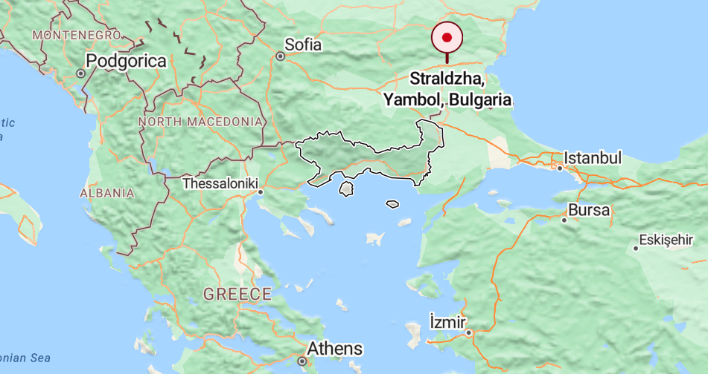
Sheep and Goat Pox
Greece
Continues to report cases
Anatoliki Makedonia Kai Thraki
21 Aug 2024
30 Aug 2024
5 Sep 2024
Bulgaria
First confirmation (4 Sep 2024)
3 cases in Straldzha, Yambol region
Notes:
Sheep and goat pox was confirmed in Bulgaria on September 4, 2024. This is the first occurrence, which consisted of 3 cases in the Yambol region (as seen marked on the map).
It was also reported on three dates in August and September in Greece (in the region outlined in the map).

Slide 10
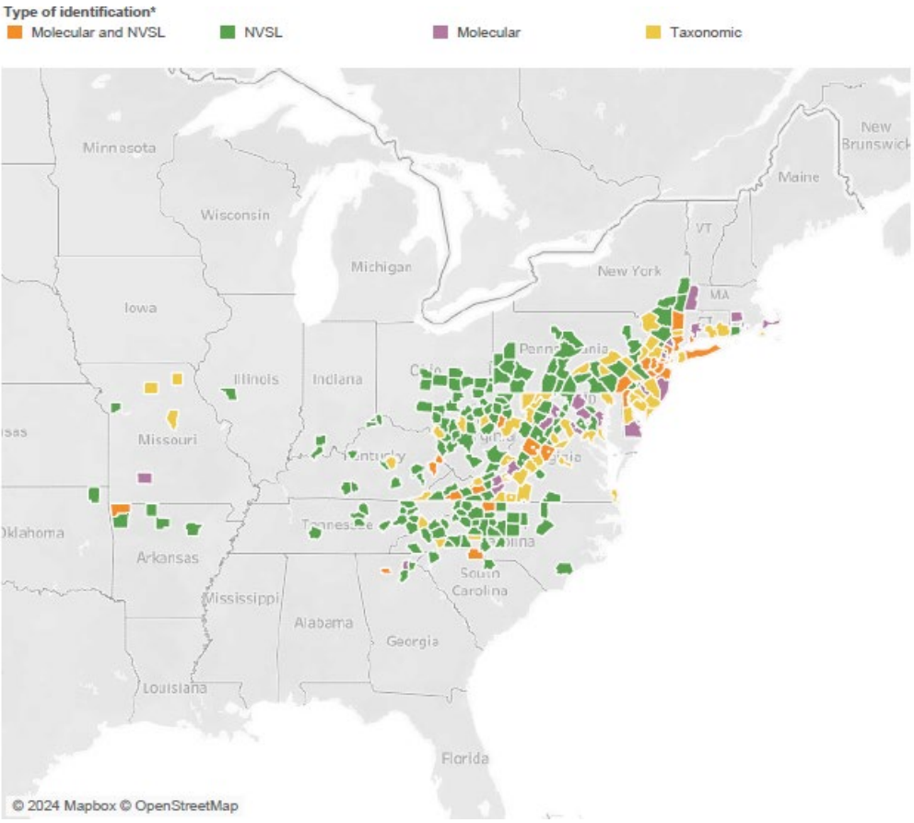
Longhorn Tick and Theileriosis in the USA
Oklahoma – new state reporting finding the ALHT
Originally reported as Mayes County, but that’s where the office it, pasture is in Craig County
July 31, 2024 – 13 female ticks collected from 22 cows that were off loaded at a barn in Missouri, all ticks were engorged
R. rickettsi has been found in a field collected tick in New Jersey (1st finding of this pathogen)
Haemaphysalis longicornis (Acari: Ixodidae) does not transmit Babesia bovis, a causative agent of cattle fever
USDA Haemaphysalis longicornis (Asian longhorned tick) Situation Report
Notes:
Oklahoma now the 21st state to report the ALHT.
R.Rickettis has been found in a field collected tick from New Jersey (they has tested 187 pools, 1248 ticks – 1 tick was positive for R. rickettsia)
Also a recent finding that the LHT does not transmit Babesia bovis

Slide 11
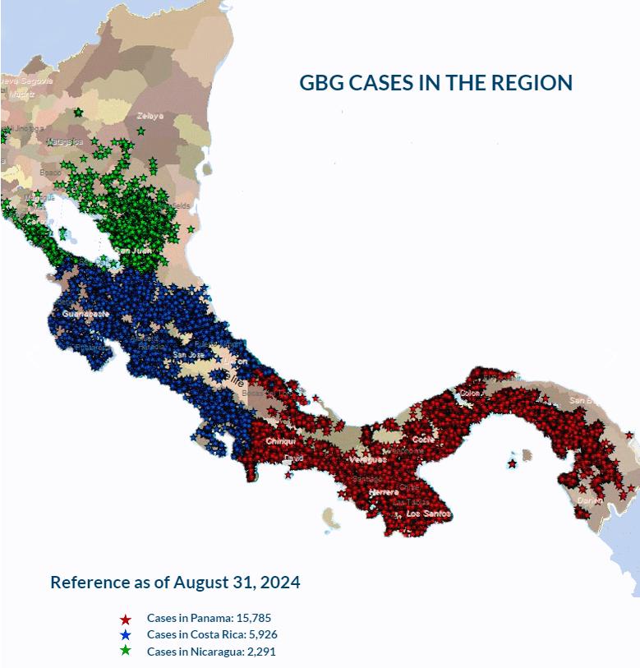
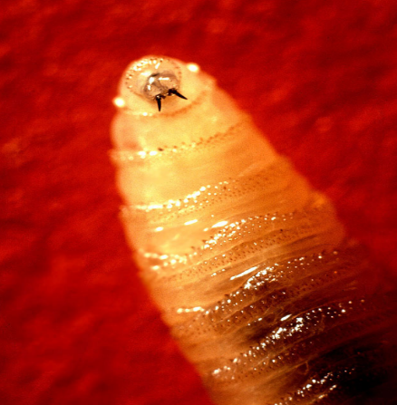
New World Screwworm in South America
Parasitic fly larva - Cochliomyia hominivorax causing wound myiasis
February 2024 – Costa Rica declared a sanitary emergency due to presence/spread of the screwworm
March 2024 – Costa Rica reported 1st human case
As of August 31, 2024, according to COPEG:
Panama – 15,785 cases
Costa Rica – 5,926 cases
Nicaragua – 2,291 cases
July 29, 2024 – Costa Rica reported 22 human cases
July 29, 2024 – Panama reported 49 human cases
Sept 9, 2024 – Nicaragua reported at least 2 human cases
Increase in cases may be due to more aggressive fly as well as increased rainfall
COPEG
Notes:
Now for the New world Screwworm, I’m not sure if we included this in this network report previously but it does have a wide host range which can include small ruminants.
So it has been spreading through central America, moving north from Panama to Costa Rica to Niaragua.
In Feb 2024 – Costa Rica declared a sanitary emergency due the the presence of the screwworm, and then in March 2024 they reported their first human case.
As of August 31, 2024:
Panama has reported 15,785 cases
Costa Rica – 5,926 cases
Nicaragua – 2,291 cases
Note Copeg cases – unsure if this include human cases along with the animal cases or just the animal cases.
As of July 29, 2024 Costa Rica has reported 22 human cases and Panama has reported 49 human cases (age range from 1 year to 95 years).
Nicaragua, as of Sept 9, reported its first two human cases of the Screwworm.
The increase in cases in Costa Rica may be due to a more aggressive strain of fly, that moves faster and prefers to mate with field flies (as opposed to sterile flies), which has reduced the effectiveness of the sterile fly control program.
Increased rainfall has also been implicated as it may lead to may parasitic activity.
There is also concern for wildlife (deer, wild boar, coyotes…) in these countries, but due to their habitats its hard to determine the exact number of animals affected

Slide 12
Q Fever
Scientific Findings
A systematic review of global Q fever outbreaks
Outbreaks mostly in industrialised nations
Most outbreaks associated with living in proximity to livestock holdings
Most common route of infection: Indirect transmission
Principal risk factors for infection: Exposure to ruminants and/or their products (sheep>goats>cattle)
Serosurveillance of Coxiella burnetii in feral swine populations of Hawai'i and Texas identifies overlap with human Q fever incidence
Feral swine are invasive in the United States, and could contribute to the spread of Coxiella burnetii
Seropositivity rates: 0.19% in Hawai’i; 6.03% Texas
Identified an overlap between seropositivity of feral swine and human Q fever incidence in Texas
Caused by Coxiella burnetti
First case of human transmissible Q fever in Philippines (Marinduque) from US-imported goats (confirmed 19 Jun 2024)
Recurrence in Montenegro in cattle (19 Jul 2024)
Notes:
Turning over to Q fever.
The first case of human transmissible Q fever in US-imported goats was confirmed on June 19, 2024 in the Philippines on the island of Marinduque.
The Department of Agriculture-Bureau of Animal Industry (DA-BAI) confirmed the Q fever in dozens of goats imported from the United States, which were bought at a government breeding farm in Marinduque and a quarantine facility in Pampanga. Out of the 94 goats which arrived in the country, 19 samples tested positive for Q fever.
(More specifically, the affected population included: 67 imported Anglo-Nubian goats (57 does and 10 bucks) and seven kids. Three does died. 10 local goats. Six adult cattle and one calf, though there were no positive cases reported in the cattle).
(Additional media article: https://www.gmanetwork.com/news/topstories/nation/910792/da-bai-confirms-first-case-of-human-transmissible-q-fever-in-us-imported-goats/story/#:~:text=Upon%20receiving%20information%20of%20the,importation%20of%20goats%20from%20the)
Two Scientific Findings are mentioned here.
First A systematic review of global Q fever outbreaks - PubMed (nih.gov)
The purpose of this study was to systematically review previous investigations of outbreaks and summarise important epidemiological features to improve knowledge of the factors driving the occurrence of Q fever outbreaks and assist decision makers in implementing mitigation strategies.
Outbreaks were reported across 27 countries and mostly in industrialised nations.
Q fever outbreaks varied in size (2 to 4107 cases) and duration (4 to 1722 days).
Most outbreaks (43/81) occurred in communities outside of traditional at-risk occupational settings and were frequently associated with living in proximity to livestock holdings (21/43).
Indirect transmission via environmental contamination, windborne spread or fomites was the most common route of infection, particularly for large community outbreaks. Exposure to ruminants and/or their products were confirmed as the principal risk factors for infection, with sheep (28/81) as the most common source followed by goats (12/81) and cattle (7/81).
The second scientific finding is about Serosurveillance of Coxiella burnetii in feral swine populations of Hawai'i and Texas identifies overlap with human Q fever incidence - PubMed (nih.gov)
Feral swine are invasive in the United States and a reservoir for infectious diseases.
The increase in feral swine population and the geographic range are a concern for the spread of zoonotic diseases to humans and livestock.
Feral swine could contribute to the spread of Coxiella burnetii
Seropositivity rates were as high as 0.19% and 6.03% in Hawai'i and Texas, respectively.
Feral swine cannot be ruled out as a potential reservoir for disease transmission and spread.
In Texas, we identified the overlap between seropositivity of feral swine and human Q fever incidence.
Results indicate that there is a potentially low but detectable risk of C. burnetii exposure associated with feral swine populations in Hawai'i and Texas.

Slide 13
Scientific Findings
Notes from the Field: Anthrax on a Sheep Farm in Winter — Texas, December 2023–January 2024 | MMWR (cdc.gov)
Comprehensive meta-analysis of severe fever with thrombocytopenia syndrome virus infections in humans, vertebrate hosts and questing ticks - PubMed (nih.gov)
First findings of Sarcocystis species in game deer and feral pigs in Australia - PubMed (nih.gov)
Circulation of small ruminant lentivirus in endangered goat and sheep breeds of Southern Italy – ScienceDirect
An 8000 years old genome reveals the Neolithic origin of the zoonosis Brucella melitensis | Nature Communications
Scrapie versus Chronic Wasting Disease in White-Tailed Deer - Volume 30, Number 8—August 2024 - Emerging Infectious Diseases journal – CDC
First Description of Mycoplasma agalactiae Anatomical Localization in Naturally Infected Hard Ticks (Rhipicephalus bursa) - PubMed (nih.gov)
The impact of the bluetongue serotype 3 outbreak on sheep and goat mortality in the Netherlands in 2023 - ScienceDirect

