Slide 1
Community for Emerging and Zoonotic Diseases Identifying emerging risks through collective intelligence
CEZD – CAHSS Poultry Update
06 September 2024
www.cezd.ca

Slide 2
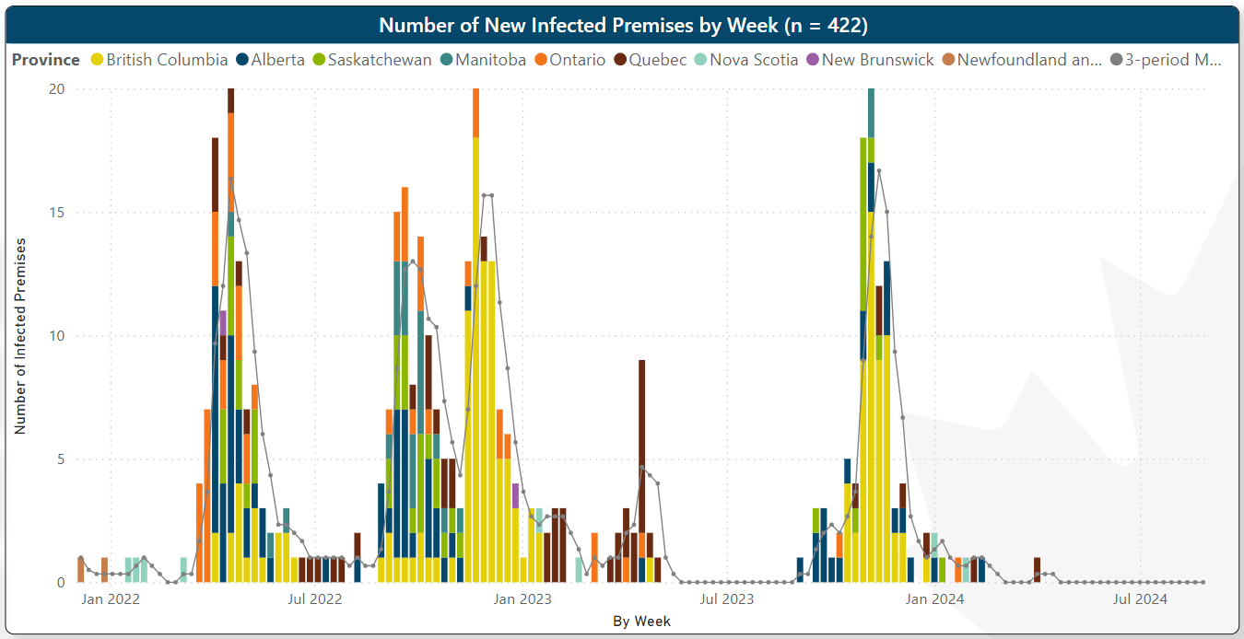
HPAI in Domestic Birds in Canada
Microsoft Power BI
Notes:
Domestic birds in Canada, our last case was on April 1 in Quebec.
Spring and Summer have been free of domestic cases of HPAI

Slide 3
Wildlife H5N1 Avian Influenza
Dashboard Filtered from June 7 2024 – Sept 4, 2024
No new confirmed cases on dashboard
3 Ring billed gulls at same location in Ontario
Results pending
Positive cases reported to WOAH from BC, SK and ON
CWHC
Wild Bird Dashboard

Slide 4
United States – HPAI Domestic Bird Detections Last 30 days
Only Florida has had outbreaks in the last 30 days
1 backyard flocks
Confirmations of Highly Pathogenic Avian Influenza in Commercial and Backyard Flocks | Animal and Plant Health Inspection Service (usda.gov)

Slide 5
US Wild Bird Detections Aug 3 – Sept 3, 2024
No wild bird detections of HPAI in the last 30 days
Detections of B3.13 associated have only been associated with Peri-domestic birds since the cattle was detected
No migratory birds have been found with this genotype
HPAI Detections in Wild Birds (usda.gov)

Slide 6
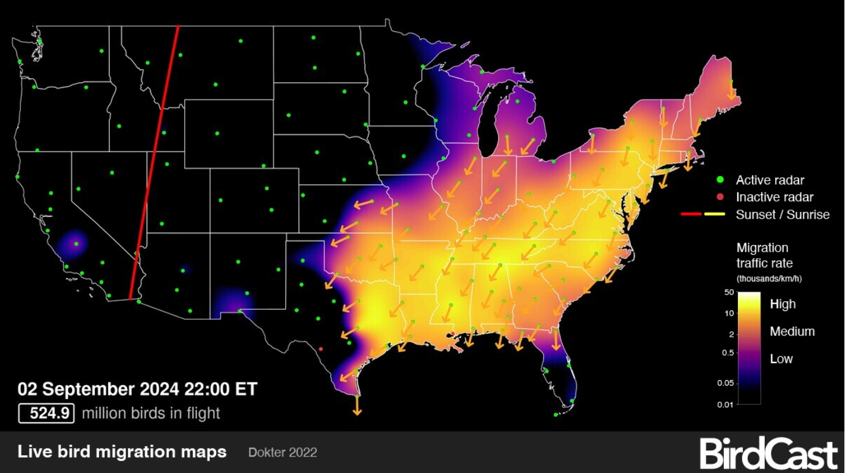
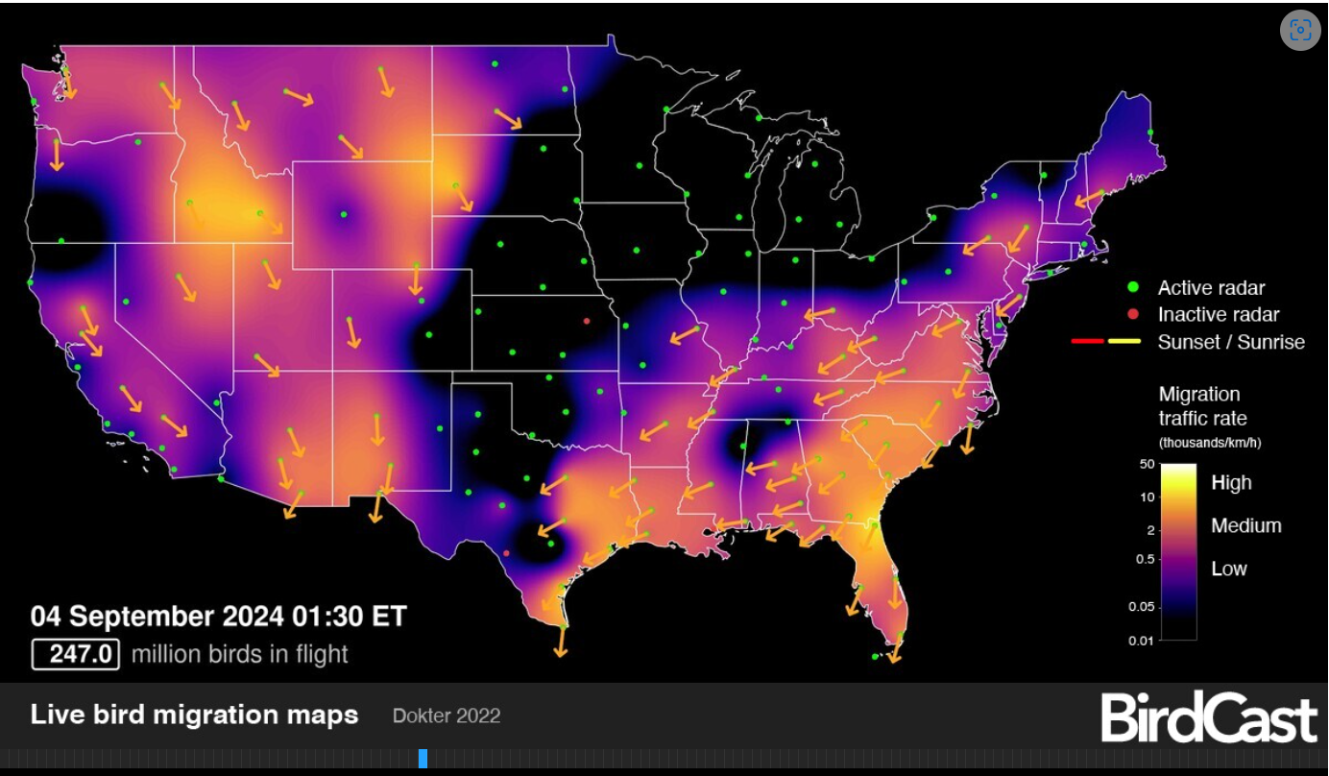
Wild Bird Migration
Notes:
Wild bird migration is well underway with 500 million + birds in flight at different times this week. Overlapping all flyways

Slide 7
Ongoing Cases of HPAI Globally
Australia (H7s)
Victoria (8), New South Wales (6), Australian Capital Territory (2)
Asia
India has reported an outbreak of HPAI H5N1 in domestic poultry in Odisha, Puri district; ~20,000 birds will be culled
Cambodia H5N1 EMPRES-i ::: Disease Event Details (fao.org)
China wild birds H5N1 WAHIS (woah.org)
Taiwan has reported two outbreaks of HPAI H5N1 in commercial poultry in Dounan Township
Bhutan has reported an outbreak of HPAI H5N1 in commercial poultry in Anderi-Doleg
Scotland EMPRES-i ::: Disease Event Details (fao.org) H5N5 Seabirds
Mexico H5N1 (domestic) WAHIS (woah.org)
South America
WAHIS (woah.org) Peru (wild and backyard)
WAHIS (woah.org) commercial and backyard)
Antarctica
Avian flu spreads across Antarctica more than expected, scientists warn (eluniversal.com.mx)
Notes:
In Antarctica, 14 new positive cases of the HPAI H5N1 have been confirmed in penguins,
seabirds, and sea lions, indicating that the spread of the virus in the southern region is greater
than expected

Slide 8
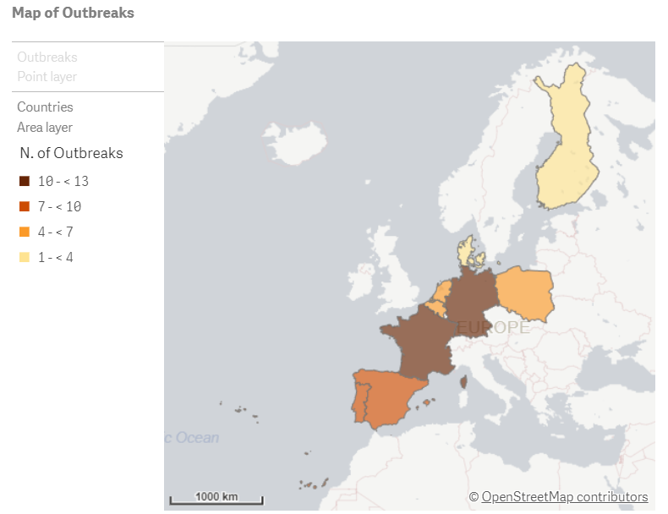
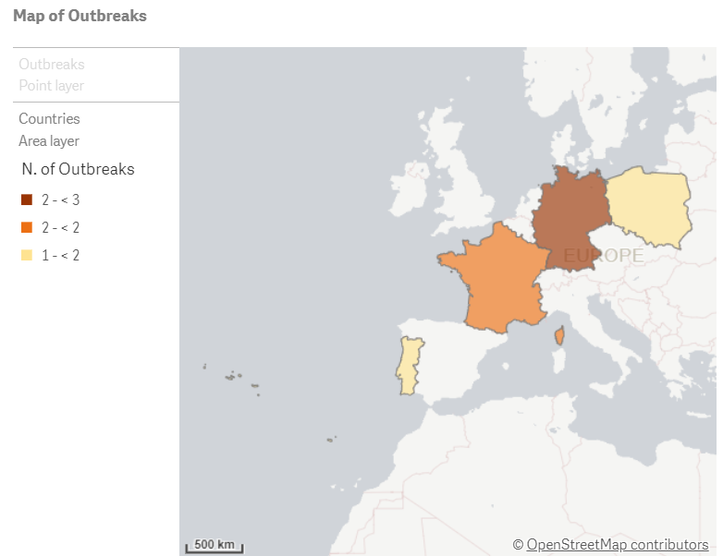
Europe
Europe
Farm Outbreaks - 4 countries affected
Germany (3) (1-H7N5)
France (2)
Poland (2)
Portugal (9)
Wild Bird Detections – 9 countries
Germany (12)
France (13)
Poland (5)
Portugal (8)
Finland (1)
Belgium (5)
Denmark (2)
Spain (7)
The Netherlands (5)
All H5NX or H5N1
Notes:
Cases since our last meeting…

Slide 9
Human Cases Continue to be Reported Sporadically
The total number of humans cases associated with H5N1 in the US since April 2024 is 13.
9 cases have been associated with Colorado poultry farm depopulations
Michigan health officials - seroprevalence study (June 25, 2024) in humans exposed to infected cows. All results were negative, indicating that asymptomatic infections in people are not occurring.
On August 14, 2024, an updated joint FAO/WHO/WOAH assessment was released based on data as of July 18, 2024. The global public health risk of influenza A(H5N1) viruses is low, while the risk of infection for occupationally exposed people is low to moderate.
Finland will vaccinate up to 10,000 at risk individuals with H5N8 vaccine
International efforts underway to create mRNA vaccine against H5N1
Human cases other HPAIs continue to arise from time to time
H9N2 in India
H5N1 2.3.2.1c cases in Cambodia, recombinant with 2.3.4.4b (up to 10 cases so far)
H5N6 in China
Notes:
Human cases still reported globally
Most recent cases in North America are associated with Dairy Farms and the B3.13 genotype.
H5 infections in the Summer were associated with poultry depopulation activities in Colorado on two farms with B3.13, these are thought to be associated with very high temperatures, and procedures used for handling infected animals for depopulation rather than whole barn gassing.
Michigan’s serosurveillance of exposed dairy workers showed that none of them had seroconverted, great news as there were concerns they might be asymptomatically infected
Risk Assessment from FAO/WHO/WOAH released an updated risk assessment, public health risk for general population is low and for occupationally exposed people is low to moderate.

Slide 10
HPAI Additional Info
Vaccination
France is launching it’s second vaccination campaign starting October 1st, 2024
Ordered 68 million vaccines
70% financed by government
CAHSS Risk Communications Materials on HPAI in Cats
CEZD RQRA on HPAI in Dairy in the US

Slide 11
Because we have to have something other than HPAI
Newcastle disease in Brazil WAHIS (woah.org)
Control measures implemented (depopulation, disposal etc…)
Surveillance has not identified further animals with clinical signs of Newcastle
In Canada, additional outbreaks of avian metapneumovirus (turkey rhinotracheitis) have been reported in commercial poultry farms across Ontario, bringing the nationwide total of affected premises to 44 WAHIS (woah.org)
Please note, reporting on aMPV is done on a 6 monthly basis and the numbers of cases have risen above the posted total.
Notes:
Brazil's official veterinary services (OVS) confirmed an outbreak of Newcastle disease in a broiler farm in the state of Rio Grande do Sul. Gene sequencing identified virulent Newcastle disease virus, with amino acid sequence 112R-R-Q-K-R116 at the C-terminal end of the F2 protein and an F (phenylalanine) residue at position 117 at the N-terminal end of the F protein. The nucleotide sequence obtained for the F gene showed 95.15% identity with the Pigeon paramyxovirus 1 (PPMV-1) sequence deposited in GenBank KX097024.1. Viral isolation is ongoing. Infection with PPMV-1 has also been detected in synanthropic birds in the state of Rio Grande do Sul as part of the surveillance of avian respiratory and nervous syndrome. OVS is conducting an epidemiological investigation of the event and implementing the restrictions and measures in accordance with the National Contingency Plan for Zoosanitary Emergencies. Update on July 25th: Epidemiological investigation conducted by the Offical Veterinary Services in the perifocal and surveillance areas has not identified animals presenting clinical signs compatible with Newcastle disease.

Slide 12
Scientific Findings – 222 relevant HPAI papers since last meeting….
The panzootic spread of highly pathogenic avian influenza H5N1 sublineage 2.3.4.4b: a critical appraisal of One Health preparedness and prevention – ScienceDirect
A One Health Investigation into H5N1 Avian Influenza Virus Epizootics on Two Dairy Farms | medRxiv
Spatiotemporal patterns of low and highly pathogenic avian influenza virus prevalence in murres in Canada from 2007 to 2022—a case study for wildlife viral monitoring (facetsjournal.com)
Risk for Waterborne Transmission and Environmental Persistence of Avian Influenza Virus in a Wildlife/Domestic Interface in Mexico | Food and Environmental Virology (springer.com)
Pathogens | Free Full-Text | Quantitative Risk Assessment of Wind-Supported Transmission of Highly Pathogenic Avian Influenza Virus to Dutch Poultry Farms via Fecal Particles from Infected Wild Birds in the Environment (mdpi.com)
Multiple transatlantic incursions of highly pathogenic avian influenza clade 2.3.4.4b A(H5N5) virus into North America and spillover to mammals – ScienceDirect
Avian influenza viruses in wild birds in Canada following incursions of highly pathogenic H5N1 virus from Eurasia in 2021–2022 | mBio (asm.org)

