Slide 1
Community for Emerging and Zoonotic Diseases Identifying emerging risks through collective intelligence
CEZD – CAHSS Companion Animal Network Update
07 April 2025
www.cezd.ca
Notes:
CEZD ~3 month environmental scanning update

Slide 2
Multiple cases of HPAI in cats globally
New Jersey Department of Health | News | H5 Highly Pathogenic Avian Influenza Confirmed in New Jersey Cat
Oregon 3 more Portland-area cats test positive for bird flu as infections spread - oregonlive.com
Washington News Releases | Washington State Department of Agriculture
Italy Italy: A cat in Bologna tests positive for avian influenza | Infectious Diseases 2025 | Infectious diseases | Poultrymed
USDA lists 131 infected domestic cats to date
India Highly Pathogenic Avian Influenza A (H5N1) Clade 2.3.2.1a virus infection in domestic cats, India, 2025 | bioRxiv
Belgium Avian influenza: two cats of a poultry keeper infected, a first in Belgium - RTBF Actus

Slide 3
Exposure Routes
Exposure to humans
Highly Pathogenic Avian Influenza A(H5N1) Virus Infection of Indoor Domestic Cats Within Dairy Industry Worker Households — Michigan, May 2024 | MMWR
Household 1 – owner worked on dairy farm but not in contact with animals,
3 cats entirely indoors, 1 confirmed positive for H5N1 2.3.4.4b B3.13 strain (died), 1 ill but not tested, 1 not ill
Household 2 – owner transported raw milk for farms, was routinely splashed with milk.
1 of 2 cats rolled on owners work clothing; cat died of H5N1 2.3.4.4b B3.13, 2nd cat did not exhibit this behaviour and tested negative
USA - Raw Pet Food
December 2024
Northwest Naturals
Monarch Raw Pet Food
February/March 2025
Wild Coast Raw
March 2025
Savage Cat Food
H5N1 Flu and Pet Food Safety | Worms & Germs Blog
India cats fed infected poultry meat at markets resulted in 18 deaths/99 cases WAHIS

Slide 4
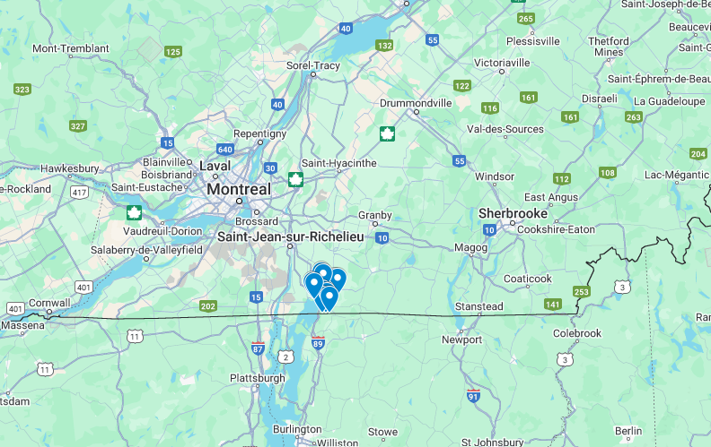
Rabies
Rabid fox detected in far northern Ontario, February 2025 - Ontario Animal Health Network
Quebec: In January 2025, multiple cases involving the Arctic fox variant of rabies were confirmed
January 6: Arctic fox in Whapmagoostui
January 8: A dog in Inukjuak
January 15: A red fox in Kattiniq
Cluster of raccoon rabies (14?) at border with Vermont
MAPAQ

Slide 5
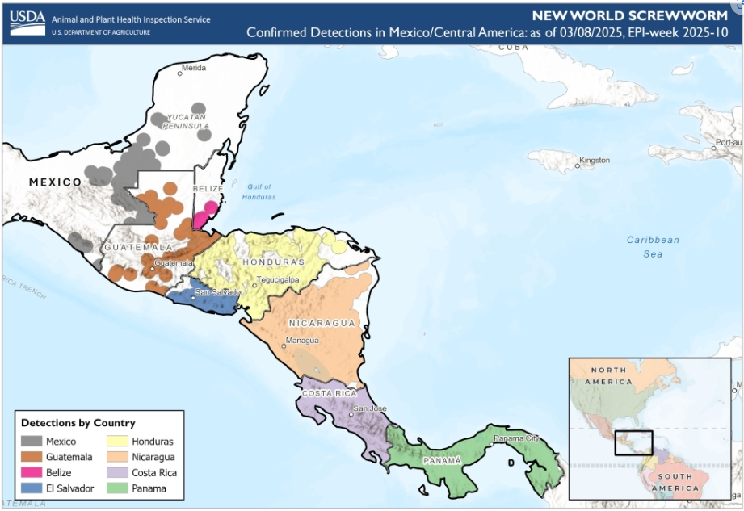
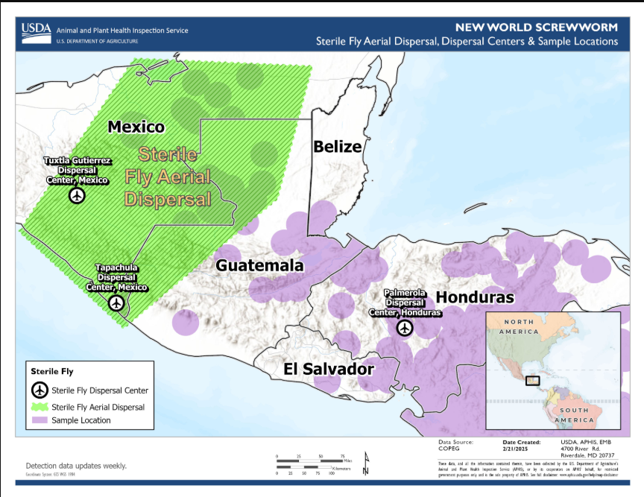
New World Screwworm in Central America and Mexico
NWS has now been found as far north as the Yucatan peninsula
COPEG maps not being updated
Sterile fly release moved to Mexico to try and prevent further northward movement
USDA states that the eradication of NWS in Central America with re-establishment of controls at the Darian gap are the aim of the program
COPEG

Slide 6
Pythiosis in dogs in Florida
Recent cases of Pythiosis in dogs in Florida
Oomycosis (more like algae than fungus)
Image Credit: Yolanda et al, 2022
Notes:
Fairly broad global distribution, mostly tropical and subtropical but some temperate cases reported also.
Cases have increased in the last decade, cases studied in Yolanda et al, 2022 - 94.3% of human cases were in India and Thailand, while 79.2% of affected animals were in the U.S.A. and Brazil.

Slide 7
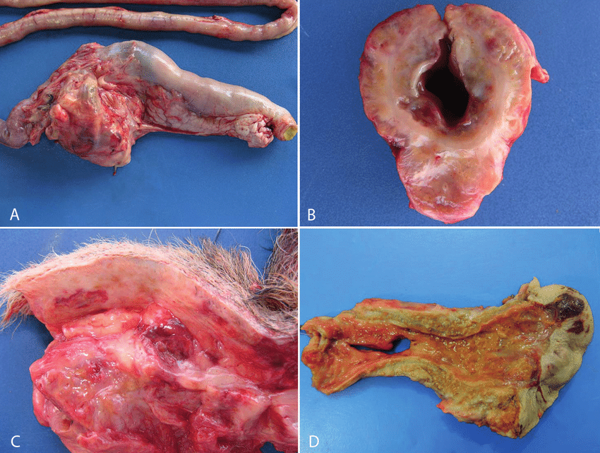
Pythiosis
Image credit: Texas A&M Veterinary Medical Diagnostic Laboratory
Cutaneous, sub-cutaneous and GI disease in dogs
Cutaneous and paranasal disease in cats
Can also affect horses, cattle, rabbits and humans
86% mortality in dogs with GI pathology
100% mortality in animals with disseminated infection
Disease and Treatment Summary
Image Credit:
SMALL ANIMAL DISEASES • Pesq. Vet. Bras. 37 (5) • May 2017
Notes:
Mortality depended on host species and clinical forms: for example, none in patients with ocular pythiosis, 0.7% in cows with a cutaneous lesion, 26.8% in humans with vascular disease, 86.4% in dogs with gastrointestinal pathology, and 100% in several animals with disseminated infection
GI and cutaneous forms of pythiosis occur in dogs and cats and are characterized by severe granulomatous and eosinophilic inflammation. P insidiosum infection occurs most often in the GI tract of young adult dogs. The stomach, proximal small intestine, and ileocolic junction are affected most commonly; however, any part of the intestine, esophagus, or colon can be diseased.
Clinical signs include vomiting, weight loss, and anorexia. The weight loss can be severe, but affected dogs usually do not appear systemically ill until late in the disease. The lesions are typically characterized by severe transmural thickening of the gastric or intestinal wall, with mesenteric lymphadenopathy in which the lymph nodes are embedded in a large, firm granulomatous mass involving the surrounding mesentery.
Bowel ischemia, infarction, or acute hemoabdomen may develop because of extension of disease into mesenteric vessels. Enteric pyogranulomas typically consist of necrotic foci infiltrated and surrounded by neutrophils, eosinophils, epithelioid macrophages, plasma cells, and multinucleated giant cells. Etiologic agents may not be apparent on sections stained with H&E. Sections stained with Gomori methenamine silver show branching, rarely septate hyphae.
Cutaneous pythiosis in small animals is typified by nonhealing wounds, invasive masses, and ulcerated nodules with draining tracts. The extremities, tail head, ventral neck, and perineum are affected most commonly. Pythiosis in cats is rare and usually consists of either cutaneous or nasopharyngeal lesions.
Wide surgical resection, including amputation, for cutaneous or GI pythiosis
In unresectable lesions, itraconazole + terbinafine + tapering prednisone

Slide 8
Scientific Findings
Highly Pathogenic Avian Influenza A(H5N1) Virus Infection of Indoor Domestic Cats Within Dairy Industry Worker Households — Michigan, May 2024 | MMWR
Eurosurveillance | Cats as sentinels of mammal exposure to H5Nx avian influenza viruses: a seroprevalence study, France, December 2023 to January 2025
Oz Virus Infection in 6 Animal Species, Including Macaques, Bears, and Companion Animals, Japan - Volume 31, Number 4—April 2025 - Emerging Infectious Diseases journal – CDC
A human pathogenic hantavirus circulates and is shed in taxonomically diverse rodent reservoirs | PLOS Pathogens
Hemotropic mycoplasmas (hemoplasmas) in indigenous populations and their dogs living in reservation areas, Brazil | Scientific Reports
Seroprevalence of Toxoplasma gondii in White-Tailed Deer (Odocoileus virginianus) in New York State
Epidemiology of Tularemia among Humans and Animals, Baden-Wuerttemberg, Germany, 2012–2022 - Volume 31, Number 4—April 2025 - Emerging Infectious Diseases journal - CDC
A wolf at the door: the ecology, epidemiology, and emergence of community- and urban-level Rocky Mountain spotted fever in the Americas in: American Journal of Veterinary Research Volume 86 Issue 3 (2025)

