Slide 1
Community for Emerging and Zoonotic Diseases Identifying emerging risks through collective intelligence
CEZD – CAHSS Companion Animal Network Update
10 October 2023
www.cezd.ca

Slide 2
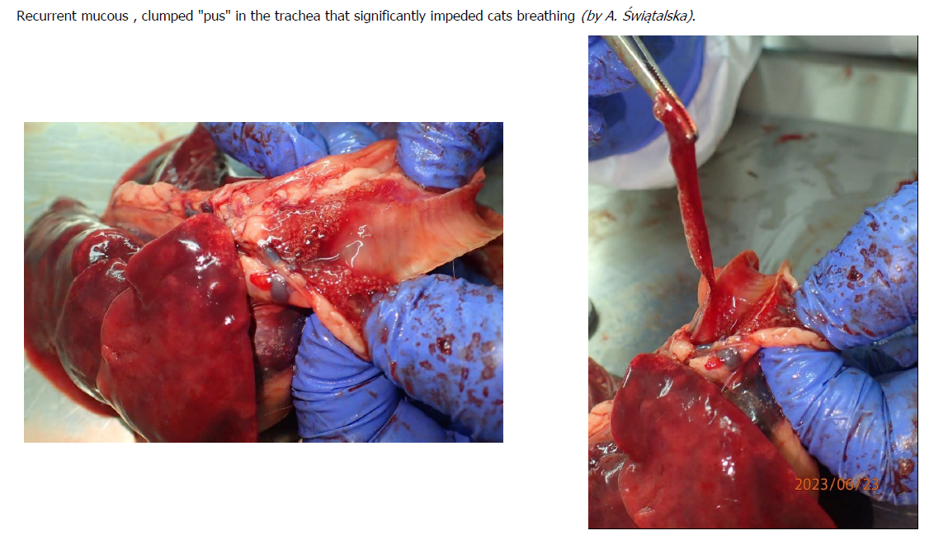
Update on HPAI in Polish Cats
Eurosurveillance | Outbreak of highly pathogenic avian influenza A(H5N1) clade 2.3.4.4b virus in cats, Poland, June to July 2023
Notes:
Researchers conducted questionnaires with veterinary clinics caring for affected cats as well as cat owners.
Data from 25 cats
12/25 were fed raw diets, 2/25 BARF diets
Clinical signs appeared 2-3 days after feeding raw meat:
loss of appetite, apathy, hypersalivation, fever, dyspnoea, hard and painful abdomen, sometimes urinary incontinence, reddened mucous membranes, followed by nervous symptoms such as epileptic seizures, increased muscle tension, inability to open jaw, and sometimes stiffness of the limbs
Post mortem examination showed mucus and pus in trachea that impeded breathing.
Lungs: congested, inflamed, hemorrhagic,
Brain: bloody fluid present in the brain cavity and subdurally
11 of the cats had lesions in every organ, the organs were congested, swollen, and bloody fluid was present.

Slide 3
Korean Shelter Cats Infected with HPAI H5N1
Ministry of Agriculture, Food and Rural Affairs > Announcements > PRESS RELEASE (mafra.go.kr)
Cats at 2 shelters in Seoul South Korea, became infected with HPAI
Mortality rate appears high “1-2 cats per day”
Ministry of Agriculture, Food and Rural Affairs > Announcements > PRESS RELEASE (mafra.go.kr)
HPAI H5N1 confirmed in pet food collected from the shelter in Gwanak-gu, Seoul; recalls have been issued for two products (Balanced Duck and Balanced Chicken) manufactured by Tosil Tosil Restaurant Brand
Lack of product sterilization

Slide 4
Experts warn about feline coronavirus after ‘thousands’ of cat deaths in Cyprus | Animals | The Guardian
July
Cyprus
1,000,000 cats on the island
Estimates range from 20-30% mortality rate
Other reports say numbers are exaggerated
Around 8,000 clinical FIP cases this year in Cyprus, veterinary association says | Cyprus Mail (cyprus-mail.com)
The Pandemic Had a Silver Lining for Cypriot Cats - The Atlantic
Government released stockpiles of antivirals to treat the cats:
Molnupiravir
Is this a ‘hot strain’?
Interacting with some genetic predisposition with the islands cats?
Recombination with COVID? (unlikely)
Did having SARS-COV2 worsen FIP?

Slide 5
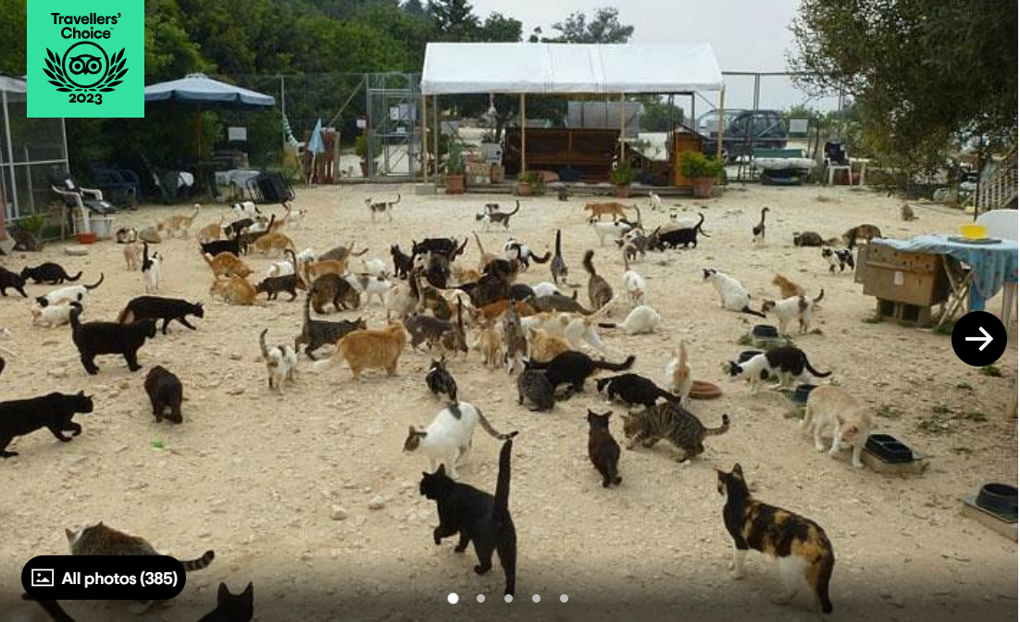
https://www.tripadvisor.co.uk/Attraction_Review-g2095514-d3983077-Reviews-Tala_Monastery_Cat_Park-Tala_Paphos_District.html

Slide 6
First Case of Zoonotic Transmission of Streptococcus equi Subspecies zooepidemicus From Cat to Human
Soft tissue infection and bacteremia in an elderly patient (90)
Lived alone in ground floor apartment, no pets
She attempted to feed a feral cat in her garden, and it bit her on right arm
Cat had an obvious nasal discharge
Within hours of the bite she had soft tissue swelling and tenderness
48 hours after the cat bite she developed a fever and somnolence
No visible wound on right arm
Developed sepsis due to cellulitis
Recovered with antibiotic treatment

Slide 7
HAIRS risk assessment: Brucella canis - GOV.UK (www.gov.uk)
Britain has had increasing detections of B. canis since 2020
B. canis became notifiable in England, Scotland and Wales in 2021, N. Ireland (2004)
Cases in dogs are associated with dog importation from Eastern Europe
Between 2018 and 2022 between 240,000 - 350,000 dogs imported each year
Dogs – prevalence of disease in UK is <.05% based on export testing data
Recent detections in dog breeding operations were first examples of dog to dog spread
Probability of infection of humans
General population = very low
Those with high risk of exposure to infectious material from infected dogs = Low

Slide 8
Canine Influenza – ongoing detections in the US
Oklahoma – August
Oklahoma City animal shelter closes for third time amid suspected canine flu outbreak | KOKH (okcfox.com)
California – October
Outbreak of dog flu hits Oakland (mercurynews.com)
Washington DC
Canine influenza making rounds through DC-area pet hospitals, shelters - WTOP News

Slide 9
Scientific Publications of Interest
TropicalMed | Free Full-Text | Monitoring SARS-CoV-2 Seroprevalence in Domestics and Exotic Animals in Southern France (mdpi.com)
The neuropathogenesis of highly pathogenic avian influenza H5Nx viruses in mammalian species including humans: Trends in Neurosciences (cell.com)
Eurosurveillance | Emergence and potential transmission route of avian influenza A (H5N1) virus in domestic cats in Poland, June 2023
Emergence of a novel reassortant H5N6 subtype highly pathogenic avian influenza virus in farmed dogs in China - Journal of Infection (behind paywall)
Understanding the divergent evolution and epidemiology of H3N8 influenza viruses in dogs and horses | Virus Evolution | Oxford Academic (oup.com)
Eurosurveillance | Asymptomatic infection with clade 2.3.4.4b highly pathogenic avian influenza A(H5N1) in carnivore pets, Italy, April 2023
Soft Tissue Infection of Immunocompetent Man with Cat-Derived Globicatella Species - Volume 29, Number 8—August 2023 - Emerging Infectious Diseases journal – CDC
Full article: The emergence of Brucella canis as a public health threat in Europe: what we know and what we need to learn (tandfonline.com)

