Slide 1
Community for Emerging and Zoonotic Diseases Identifying emerging risks through collective intelligence
CEZD – CAHSS Small Ruminant Network Update
13 September 2023
www.cezd.ca

Slide 2
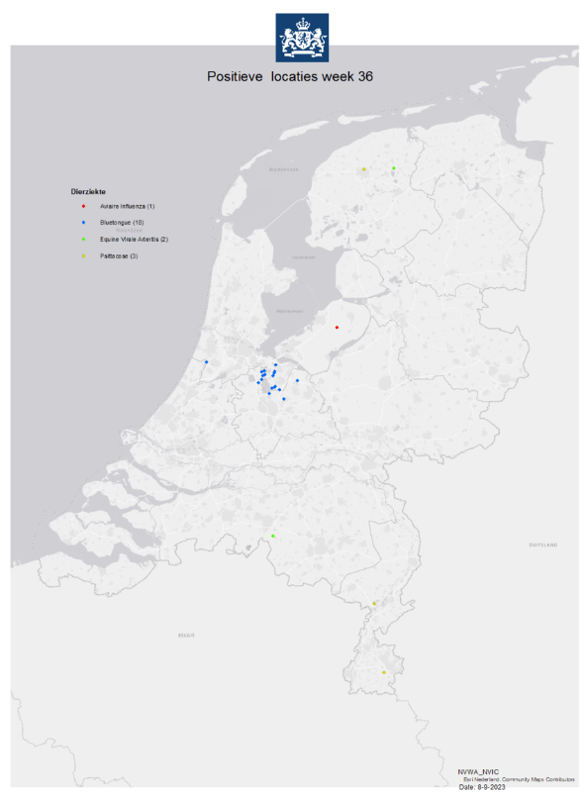
Bluetongue in the Netherlands
Sept 5th, the Netherlands reported 4 cases of Bluetongue, now up to 18.
Unofficial report Serotype 3 (no vaccine for Serotype 3)
Export ban has been implemented on live ruminants, including semen and embryos
Source of infection currently unknown
BTV in the Netherlands in 2006 – Serotype 8
Controlled with vaccination program
Last occurrence 2009
Declared freedom in 2012
Notes:
Bluetongue virus is a category C disease according to the Animal Health Regulation (EU). This means that there is a reporting obligation for the bluetongue virus, but no obligation to combat it. Suspicions of an infection with bluetongue must be reported to the NVWA.
An investigation has begun into the source of the infection and the farms involved are no longer allowed to move live animals as a temporary measure. Adema said he is in talks with sector representatives and is investigating the possibilities of a suitable vaccine.
Bluetongue is spread by midges, not by direct contact between animals, opening up the possibility of more cases in the next few weeks, Adema said. Farmers have been told to use insect repellents to stop the disease from spreading.
Contrary to bird flu, foot and mouth disease or mad cow disease, no animals will have to be destroyed as a result of the disease, which is characterised by high fever, swelling of the lips and red to purply mucous membranes of the mouth and tongue.

Slide 3
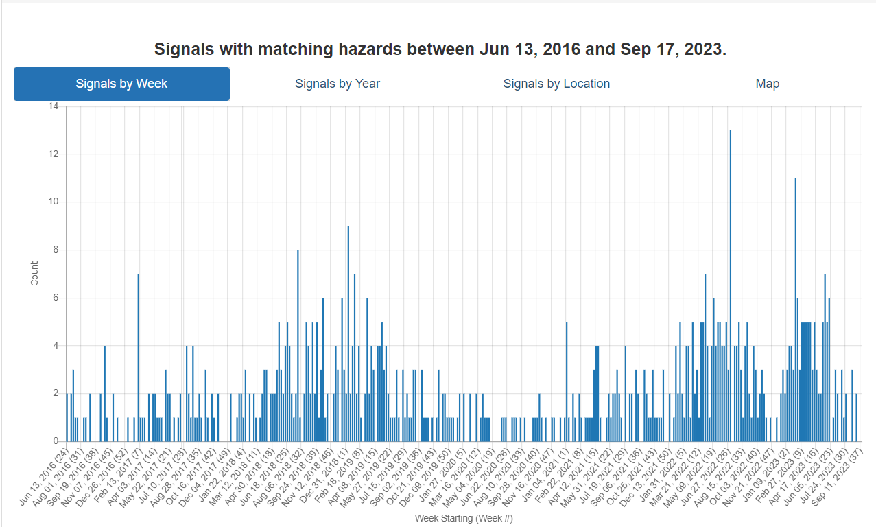
Foot and Mouth Disease Trends
Covid in 2020
?
Covid in 2021
?
Notes:
There is a trend visible here.
The first peak on the right side is due to FMD in Indonesia, and the second that we’re seeing now is due to SAT-2 in the middle east.
Reporting dropped off in 2020-21 and we speculate that is due to COVID.

Slide 4
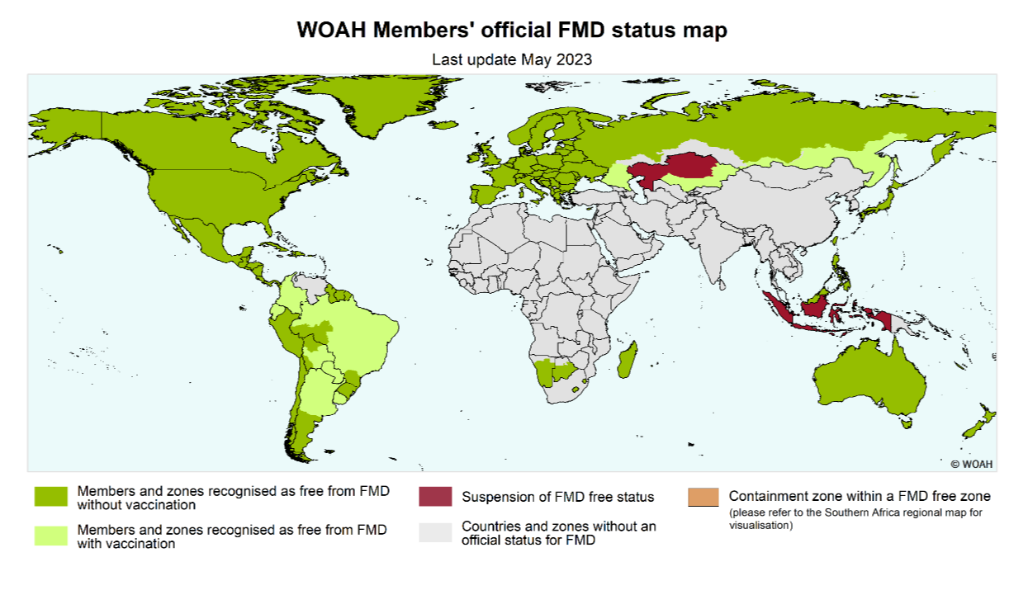
Foot and Mouth Disease – Global Distribution
Notes:
FMD serotype SAT-2 is exotic to Eurasia, and is known to circulate in multiple African countries (pools 4, 5, and 6). SAT-2 may demonstrate more aggressive infectious activity compared to other FMD serotypes, especially when introduced to naïve populations, like those in Eurasia and the Middle East. Animals vaccinated against other serotypes of FMD would not have cross protection.

Slide 5
FMD virus type SAT-2
Spread in the Middle East and Western Asia
More aggressive than the other serotypes present in the region
So far in 2023 outbreaks have been reported in Türkiye, Jordan, Iraq, Oman
EU FMD vaccine bank released SAT-2 monovalent vaccines to Türkiye
Russia has released 3.5 million doses of a vaccine containing strain SAT-2
2.5 million doses released to countries of the Persian Gulf
Iran has a large susceptible population (5.4 million cattle and 58.2 million small ruminants)
Notes:
Most recently in 2023, outbreaks of FMD SAT-2 have been reported in: Jordan (2023), Iraq (2023), and Turkey (2023). The incursion of FMD SAT-2 into this region is concerning as the introduction of exotic serotypes to a naive population usually results in severe losses in vulnerable sectors, and high mortalities in young stock.

Slide 6
Vaccination in Türkiye
High risk areas next to Armenia and Iraq
Thrace to protect the Balkan countries

Slide 7
Rift Valley Fever
Rift Valley fever (RVF) is a re-emerging zoonotic disease
Global distribution has been slowly changing
Primary hosts are ruminants, camels and humans, has broad species range
Vector borne disease – spread by mosquitos
Reportable Disease in Canada – CFIA Fact Sheet
Good import controls on live animals and animal products from affected countries
Mosquito vector translocation via airplane is plausible
Other pathways

Slide 8
Image credit: ESFA Journal 2020
Range extension from south and East Africa
To West Africa and then sub Saharan Africa
Evidence of infection now documented in Northern Africa, Indian Ocean and Middle East
Notes:
Range Extension
1931 epidemic in Kenya – virus first isolated from sheep
Since then major outbreaks in
Egypt, Kenya, South Africa, Madagascar, Mauritania, Senegal, and Gambia
Sub-Saharan Africa
2000-2001 major outbreak in Saudi Arabia and Yemen
Turkiye and Tunisia
Comoros Archipelago in Indian Ocean – 2007
Re-emergence in 2018
Libya – 2020
2 cases
Sheep
Sheep and goats

Slide 9
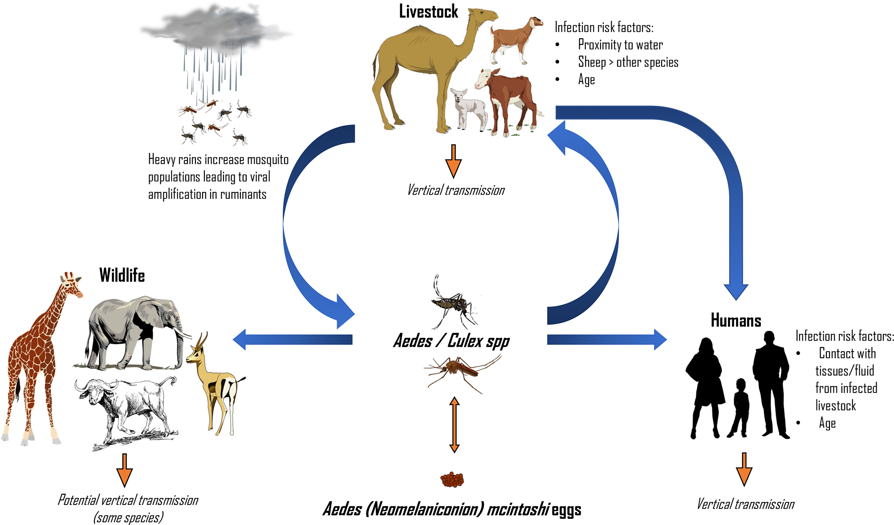
Rift Valley Fever
J. Gen. Virol. 100, 1187 (2019);
https://doi.org/10.1099/jgv.0.001296
Notes:
“RVFV cycle. Between epidemics RVFV may be maintained through transovarial transmission in Aedes (Neomelaniconion) mcintoshi eggs. Wild ungulates and livestock can also harbour low-level infection. During heavy rains, a surge in mosquito populations leads to increased infection of livestock and viral amplification between numerous vector species and ruminants occurs. As more livestock become infected, the chances of spillover into humans increases. Human infection can occur via mosquito bite, or more commonly, via contact with infected animal tissue and fluid.”
Image and text here from J. Gen. Virol. 100, 1187 (2019); https://doi.org/10.1099/jgv.0.001296
Can cause serious illness in animals
Cattle
Sheep > other species
Goats
Camels
Young affected > adults
High rates of mortality and abortion
Significant economic impact
Horizontal, vertical and vector borne transmission are possible in humans and animals
Humans infected by contact with livestock, especially blood and body fluids; consumption of unpasteurized milk
Low level of virus circulation can exist in livestock as is evidenced by seropositivity with no clinical outbreak

Slide 10
Disease in Sheep
Incubation period is 24–36 h.
Post-mortem analysis revealed multi-focal liver necrosis and occasional mild splenomegaly
Mortality Rate
Adult sheep 20-30%
Newborn lambs 95-100%
Abortion in pregnant ewes is ~100%
Lambs
Fever and high mortality
Adult Sheep
excess salivation;
loss of appetite;
nasal discharge; and
weakness or diarrhea.

Slide 11
Disease in Goats
Additional Species
Variable course of disease
Viremia and symptoms inconsistent after infection
Peak viremia is significantly lower than in lambs of identical age
Do not always experience febrile illness.
Focal hepatic lesions, followed by necrotic hepatitis.
Dogs
Abortion up to 100%
Severe disease and death in puppies
Cats: death in kittens
Horses: viremia but resistant
Pigs: resistant
Birds: refractory

Slide 12
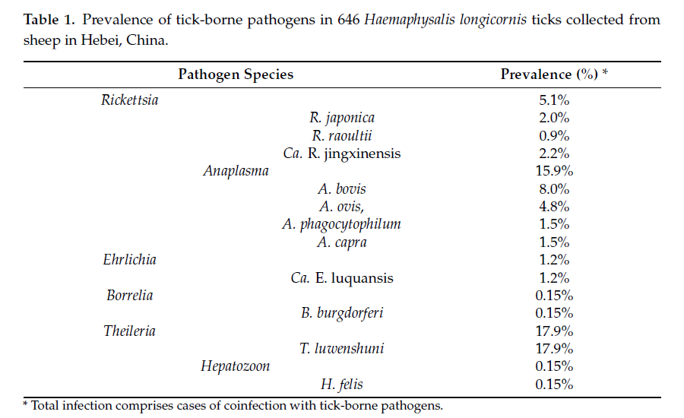
Asian Longhorned Tick
Pathogens | Free Full-Text | Molecular Detection of Tick-Borne Bacterial and Protozoan Pathogens in Haemaphysalis longicornis (Acari: Ixodidae) Ticks from Free-Ranging Domestic Sheep in Hebei Province, China (mdpi.com)

Slide 13
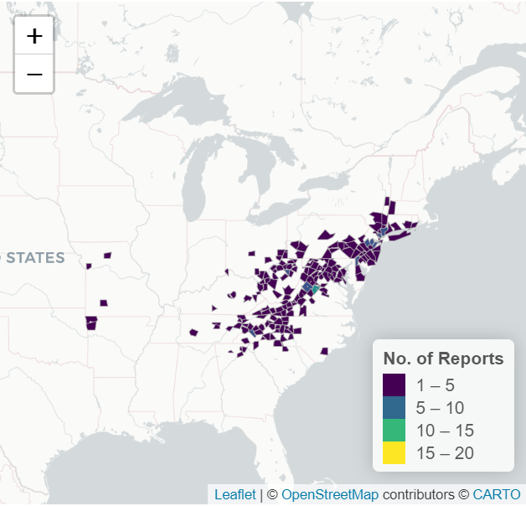
Asian Longhorned Tick Distribution in US
University of Georgia map scwds.shinyapps.io/haemaphysalis/
Allows sorting by state and county
Ongoing spread of the tick in the US

Slide 14
Scientific Findings
Epizootic Hemorrhagic Disease Virus Serotype 8, Italy, 2022 - Volume 29, Number 5—May 2023 - Emerging Infectious Diseases journal – CDC
Viruses | Free Full-Text | Evidence of Rift Valley Fever Virus Circulation in Livestock and Herders in Southern Ghana (mdpi.com)
EVIDENCE OF PROTOZOAN AND BACTERIAL INFECTION AND CO-INFECTION AND PARTIAL BLOOD FEEDING IN THE INVASIVE TICK HAEMAPHYSALIS LONGICORNIS IN PENNSYLVANIA - PubMed (nih.gov)
Ticks (Acari: Ixodida) on synanthropic small and medium-sized mammals in areas of the northeastern United States infested with the Asian longhorned tick, Haemaphysalis longicornis - PubMed (nih.gov)
Baseline Susceptibility of Haemaphysalis longicornis to Organophosphate, Carbamate, and Pyrethroid Acaricides - PubMed (nih.gov)
Researchers warning after invasive tick discovered in Missouri (fox4kc.com)

