Slide 1
Community for Emerging and Zoonotic Diseases
Identifying emerging risks through collective intelligence
CEZD – CAHSS Poultry Update
2 June 2023
www.cezd.ca

Slide 2
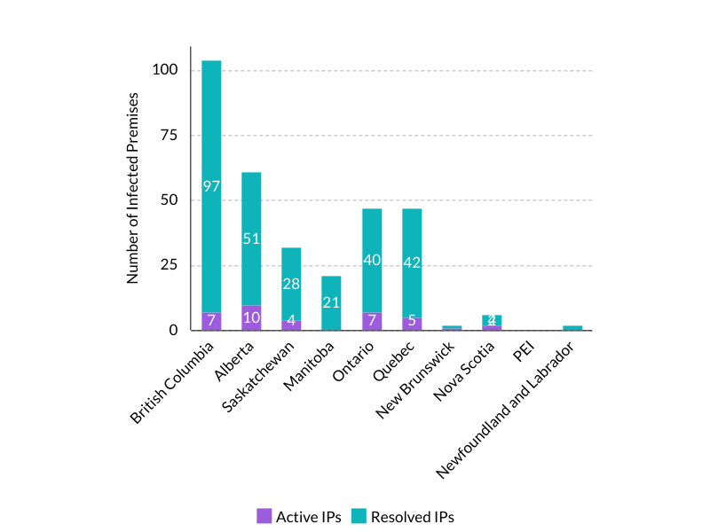
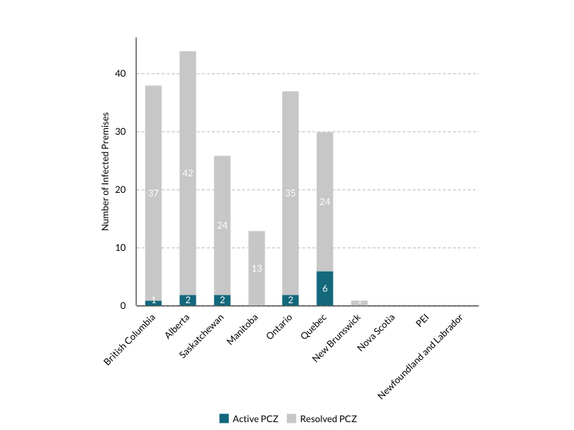
Current HPAI Infected Premises and Primary Control Zones in Canada
Active and Resolved Infected Premises
as of June 1, 2023
Active and Resolved Primary Control Zones as of June 1, 2023
Notes:
There is a very significant decrease in cases in Canada compared to last year.
April 71% decrease, May 96% decrease and the same has happened in the US, 91% decrease in cases in April and 96% decrease in May

Slide 3
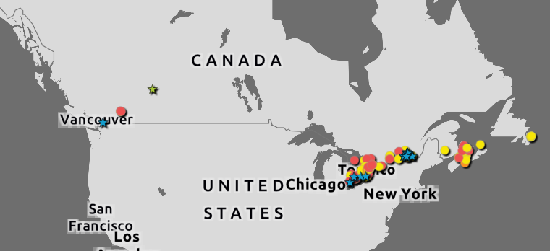
Wildlife H5N1 Avian Influenza
Fully Eurasian H5N5 in Raccoon, Red tailed hawk in PEI
Since last year:
  Minimal change in proportion of avian species affected (less seabirds)
  Significant decrease in total positive cases but also far less negative cases (less submissions)
CWHC
Wild Bird Dashboard
Notes:
Image from filtering dashboard from Mar 3 – May 31

Slide 4
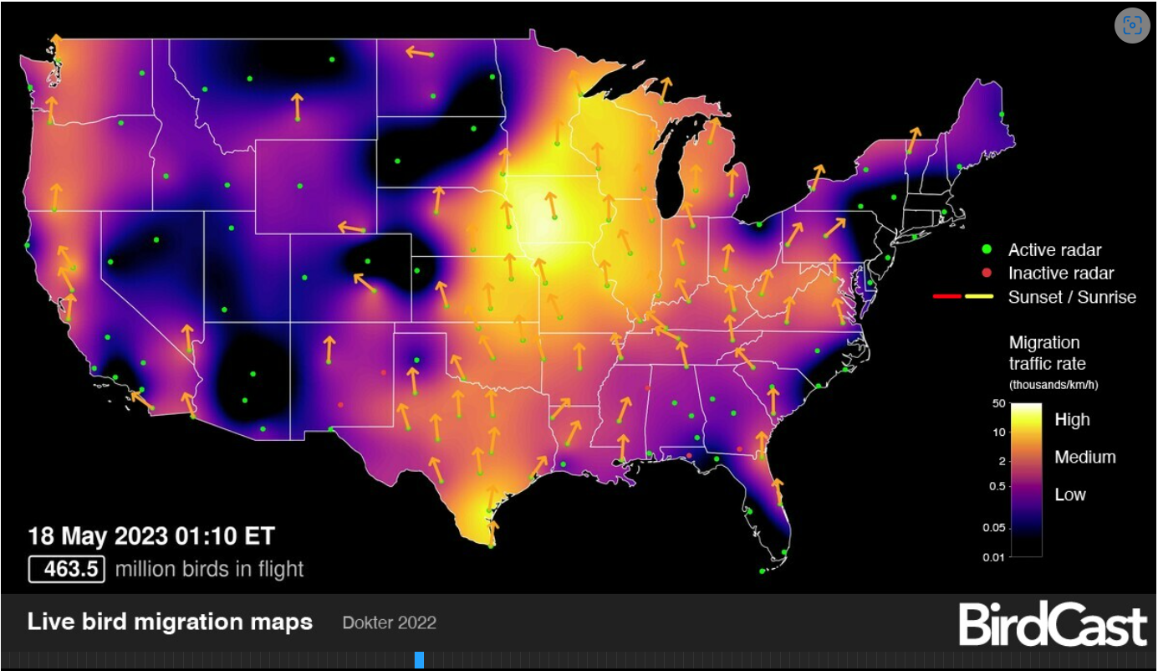
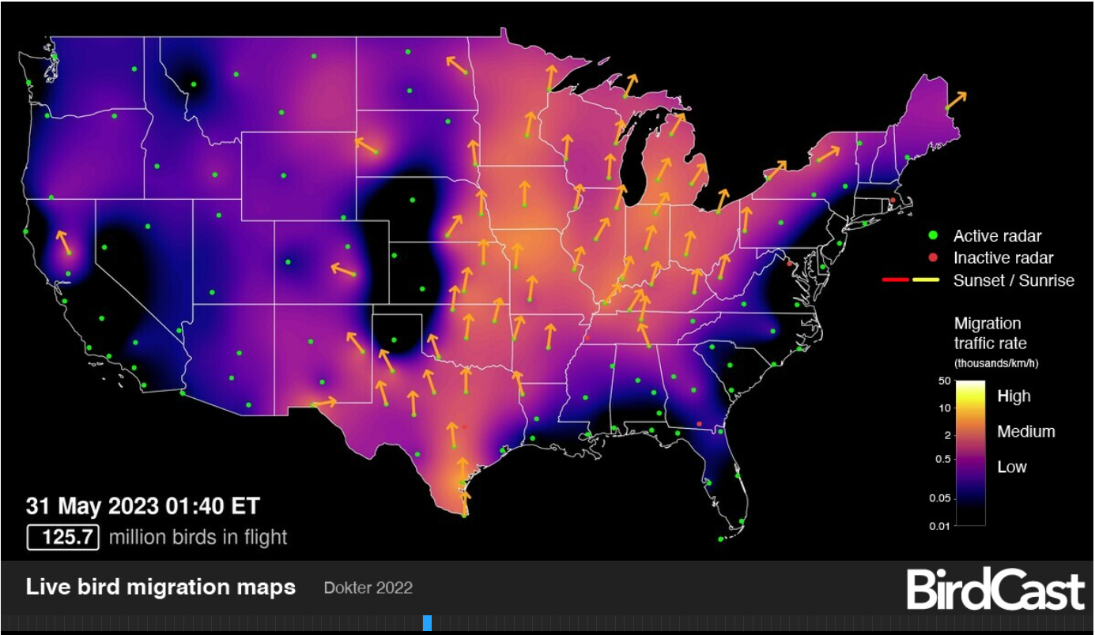
Wild Bird Migration
Notes:
Has been very intense until Mid May, slowed down somewhat this week as is expected this time of year.

Slide 5
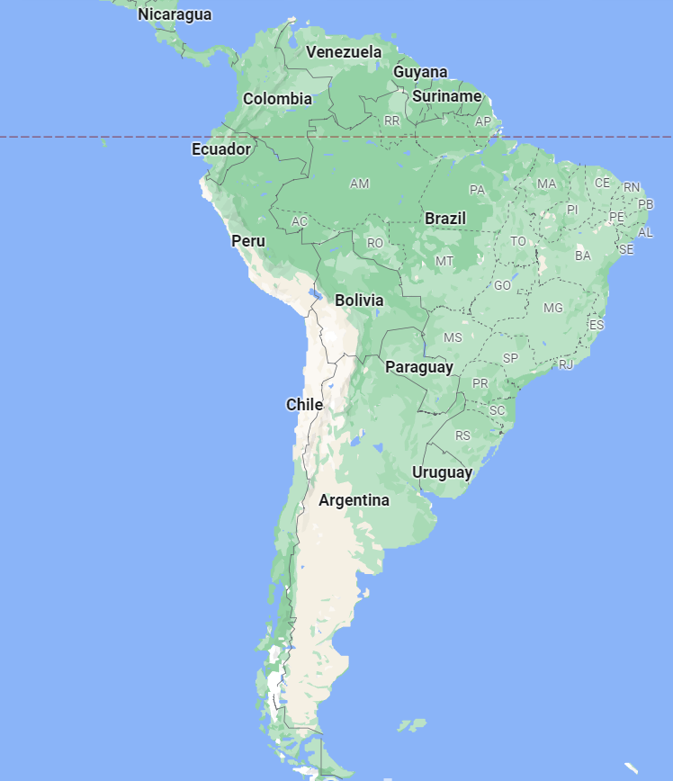
Ongoing Spread in South America
Commercial and backyard poultry
Mass mortality events in wild birds and mammals continue to be reported
Additional spread southwards and then returning north and eastward
Detections in Paraguay and Brazil are new since last meeting
Notes:
During our last meeting the virus had gone as far south as Peru, but it has since moved further south into Chile and Argentina and East and North into Brazil.

Slide 6

USDA APHIS | USDA Takes Action to Help Protect Endangered California Condors From Highly Pathogenic Avian Influenza
Critically endangered species
Pilot study to occur in North American Vultures first.
  Inactivated, killed vaccine
  Licensed by APHIS’ center for Veterinary Biologics in 2016
Emergency use for the vaccine limited to the California Condor
Not expected to impact poultry trade (considered WOAH non-poultry)
Notes:
Image from: USDA APHIS | USDA Takes Action to Help Protect Endangered California Condors From Highly Pathogenic Avian Influenza
The California Condor is critically endangered and has been affected by HPAI infection this year
Since March 14 have died from HPAI infection
Some are recovering from infection in rehab centers
Vaccine trials to start on North American vultures in May 2023 to determine if there are any negative side effects before administering to this endangered species.

Slide 7
High pathogenicity avian influenza (H5N1) in Northern Gannets: Global spread, clinical signs, and demographic consequences | bioRxiv
Performed serology on adult birds with healthy iris colour & black iris colour
  Black irises in gannets seen for the first time during HPAI outbreak
Blood & cloacal swabs from 19 birds
  All negative for virus on cloacal swabs
  8 of 17 blood samples were positive for H5 antibodies suggesting previous infection
Pre-print article
April 2022 – epidemic of H5N1 in seabirds across the North Atlantic, Northern Gannets severely affected
Gannets have 53 colonies on both sides of the North Atlantic
Study looked at the gannet colony at Bass Rock, Scotland
Looked at adult survival and breeding success
Notes:
- This is a pre-print article from mainly UK authors, some from Canada
Northern Gannets severely impacted by HPAI
Gathered info from North Atlantic Gannet Colonies
Serology found antibodies in some apparently healthy birds suggesting survival from infection
Most recovered birds had black irises – a possible phenotypic indicator of infection (instead of blue)
Two birds with black irises tested negative for H5 antibodies, perhaps they had already lost antibodies/no longer had antibody persistence

Slide 8
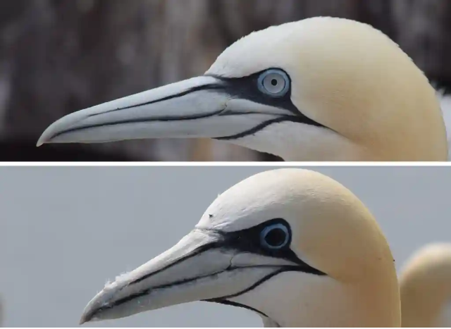
Cont’d
Likelihood of a positive test in birds with black irises was 77.7% vs. those with normal/blue irises (12.5%), p<0.05
Presence of black irises may be a non-invasive tool to determine if a bird had previous infection
More work needs to be done to determine how the colour change occurs, if this occurs in other species, and if there is any impacts on vision
Notes:
Image from: Irises of gannets that survive avian flu turn from blue to black, study finds | Birds | The Guardian

Slide 9
Transmission of lethal H5N1 clade 2.3.4.4b avian influenza in ferrets | Research Square
Pre-print articles from NML and NCFAD
5 isolates from lethal HPAI H5N1 cases:
  Blue winged teal (BWTE/MB/22)
  Red tailed hawk (RT.Hawk/ON/22)
  Domestic turkey (Turkey/ON/22)
  Red Fox (Redfox/ON/22)
  Red Fox (Redfox/PEI/22)
All were reassortant viruses except Red Fox from PEI which was wholly Eurasian
In vitro studies
  Varied results of effect of the viruses on human respiratory epithelial cells
  RT.Hawk/ON/22 replicated efficiently in upper respiratory tract cells = concern for shedding of the virus (in humans)
Inoculation of BALB/c mice with virus resulted in death.
Notes:
This is a pre-print article from colleagues at the National Microbiology Lab and NCFAD
**red tail hawk ont 22 - PB2 changes in the red tailed hawk ON isolate
**ferret to ferret transmission
** replication in human airway cells invitro
Multiple naturally circulating reassortant H5N1 viruses can replicate in primary human airway epithelial cells and cause lethal disease in multiple
mammalian species.
One isolate, A/Red Tailed Hawk/ON/FAV-0473-4/2022, efficiently transmitted by direct contact between ferrets, resulting in lethal outcomes.

Slide 10





Transmission of lethal H5N1 clade 2.3.4.4b avian influenza in ferrets | Research Square
Inoculated ferrets
developed clinical
disease
Died/euthanized
Direct contact ferrets
developed clinical disease
Died/euthanized
Airborne contact ferrets
no clinical disease
1 nasal swab from one animal
positive on day 7
On necropsy, nasal turbinates and lungs
of all animals positive for vRNA on necropsy
All isolates
RT.Hawk/ON/22 most severe lung lesions
RT.Hawk/ON/22
Notes:
Ferret study
Similar receptors to humans in the lower respiratory tract
Studied infection in an inoculated ferret and if infection would spread to cage-mate.
Inoculated ferrets showed signs of infection
Most severe lung lesions with RT.Hawk/ON/22
Cage-mates of ferrets infected with RT.Hawk/ON/22 developed disease and needed to be euthanized
Airborne transmission studied as well for RT.Hawk/ON/22
None of air-borne ‘contacts’ showed clinical signs.
1 nasal swab from one animal positive on day 7
Both nasal turbinates & lung samples from all airborne contacts were positive for viral RNA at necropsy

Slide 11
Domestic dog tests positive for avian influenza in Canada - Canada.ca
Late March/Early April
The domestic dog was found to have been infected with avian influenza after chewing on a wild goose, and died after developing clinical signs
Pet owners are advised to:
not feed pets (e.g., dogs or cats) any raw meat from game birds or poultry
not allow pets to consume or play with dead wild birds found outside
contact their veterinarian if they have questions about their pet's health

Slide 12
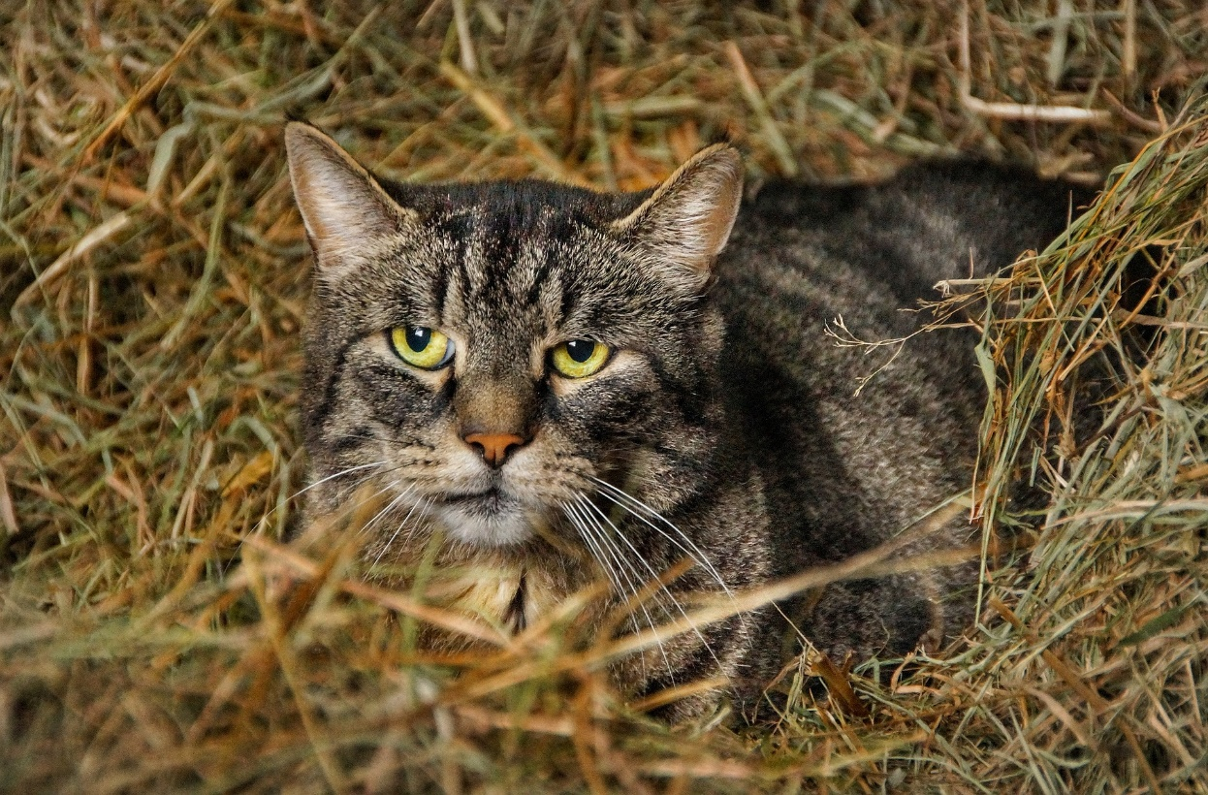
Avian Flu Diary: Nebraska Veterinary Diagnostic Center (NVDC) Report: 2 Domestic Cats Infected With HPAI H5N1 (afludiary.blogspot.com)
Wyoming:
  Barn cat likely infected by eating meat from infected waterfowl (dates not provided)
Nebraska
4 outdoor cats in 1 household
2/4 positive for HPAI H5N1
https://vbms.unl.edu/VDC/documents/HPAI_Cats.pdf

Slide 13
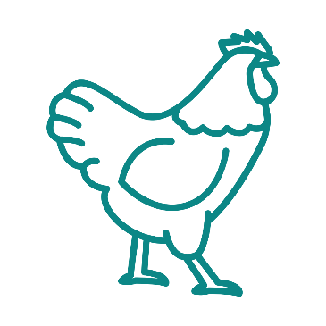


The role of airborne particles in the epidemiology of clade 2.3.4.4b H5N1 high pathogenicity avian influenza virus in commercial poultry production units | bioRxiv
Study is pre-print
Great Britain – environmental samples taken from inside and outside IPs (chicken, turkey, duck)
Clade 2.3.4.4b H5N1 HPAIV specifically
Cases in UK had clustered geographically hence interest in possibility of airborne transmission

Slide 14
The role of airborne particles in the epidemiology of clade 2.3.4.4b H5N1 high pathogenicity avian influenza virus in commercial poultry production units | bioRxiv
Notes:
Contact is Direct or Indirect
Indirect can be
Solid
Liquid
Airborne
Most common in HPAI in birds is environmental contamination via ‘liquid fomites’ = fecal oral contamination
Airborne Transmission
biological aerosols (≤5μm)
biological droplets (>5μm)
microscopic fomite particles (e.g., dust, dander, feathers)
Biological aerosols and droplets from oral or cloacal fluids that are ‘atomized’ during normal behaviours
Microscopic fomites = biological or non biological material contaminated with virus

Slide 15
The role of airborne particles in the epidemiology of clade 2.3.4.4b H5N1 high pathogenicity avian influenza virus in commercial poultry production units | bioRxiv

Slide 16
The role of airborne particles in the epidemiology of clade 2.3.4.4b H5N1 high pathogenicity avian influenza virus in commercial poultry production units | bioRxiv
Samples collected from:
Results
Air
Water
Dust on ventilation system
Feathers
Tested for:
Viral RNA
Infectious Virus
H5Nx found in all 3 IPs
Viral RNA and infectious virus in some air samples
Viral RNA transported greater distances than infectious virus

Slide 17

Results – Duck IP
Viral RNA and Infectious virus detected in air inside barn
Air within 1 m of barn vRNA positive
Vent dust samples, most positive for vRNA, 1 positive for infectious virus
2 feathers, 60 m from cull site were vRNA positive
Standing water in front of barn negative for vRNA

Slide 18

Results – Turkey IP
Infectious virus isolated from air inside turkey IP (1 barn)
vRNA found in 1 air sample 1 m from barn
All air samples 80-120m negative for vRNA
Feathers 60-80 m from cull-loading area vRNA positive
Dust inside and outside barns vRNA positive

Slide 19

Results – Chicken IP
Only 1 air sample from within 1 barn contained vRNA but no infectious virus
Air samples 5, 25 and 70 m away were negative
Feather samples inside and outside one barn (60m) were positive for vRNA
1 dust sample from outside vent vRNA positive
1 drinking water sample inside barn vRNA positive
Conclusion – risk of airborne transmission is low. Infectious HPAIV can travel short distance while particles with vRNA could be found further

Slide 20
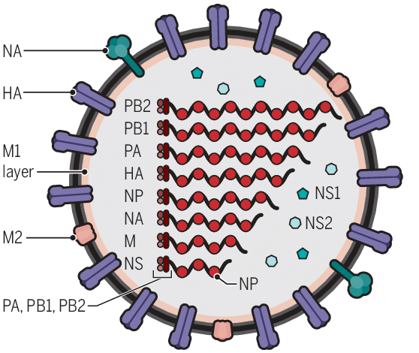
E627K Mutation on PB2
Known for facilitating mammalian adaptation
Detected in:
13 mammals
    foxes (4)
    skunks (2)
    harbor seals (6)
    raccoon (1)
5 wild carnivore birds
13 poultry farms
  12 commercial farms in QC: duck (4), turkey (4), chicken breeder (2), layer (1), broiler (1)
  1 commercial farm in ON: turkey
Source of introduction = scavengers ?
Notes:
Mutation facilitating mammalian adaptation has been found on poultry farms in Quebec.

Slide 21
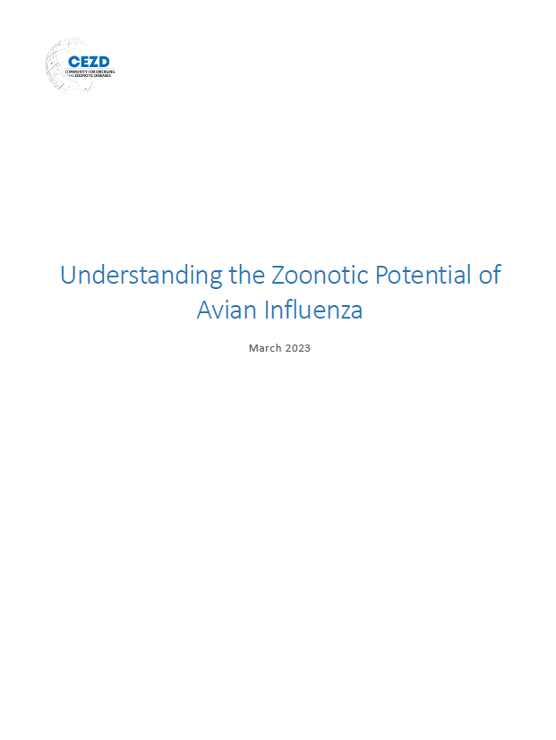
CEZD Infobulletin: Understanding the Zoonotic Potential of HPAI
Created to assist professionals in understanding the changes that need to occur for AIV to infect humans (as ‘plain language’ as possible)
Available in English and French
Notes:
Logan Flockhart and Bridget Fomenky pulled together a summary report to help professionals better understand the zoonotic potential of Avian Influenza. It is a plain language version (as plain language as AI can be) and is available in English and French on the CEZD website.

